Slide 1

What is the Goal:
John Henry, the Machine, or something else?
Dr. Benjamin Isaak Gross
Associate Professor of Political Science

Slide 2

Navigation
1. The legend of John Henry
2. Literature review
3. Analogy – The Calculator
4. How to Outsmart GenAI
5. Utilizing GenAI as a Tutor

Slide 3

1. The Legend of John Henry
Human vs. machine
Pride vs. growth
Subjugation and oppression

Slide 4
1. The Legend of John Henry
Human vs. machine
Pride vs. growth
Subjugation and oppression
What is a human?

Slide 5
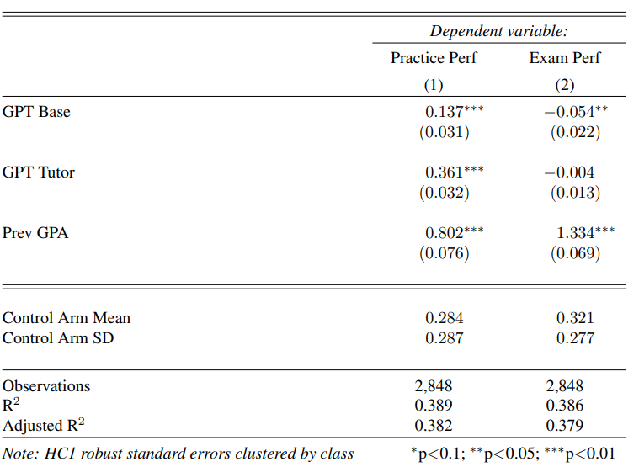
2. Literature Review
Bastani et al. (2024)
  Experimental design of ChatGPT, ChatGPT tutor, and no assistance
Notes:
Bastani et al. (2024) finds that students who used ChatGPT 4.0 (i.e., GPT 4.0) solved 48% more problems than those in the control group. Furthermore, those with the ChatGPT Tutor, which was designed to avoid errors and to provide hints to the student without directly providing the answer, solved 127% more practice problems compared to the control group.
Yet, when put in the exam setting, when access to ChatGPT was taken away, students who had access to ChatGPT 4.0 performed17% worse than students in the control group. Students who had access to the ChatGPT Tutor did not perform in a statistically significant different way from those in the control group.
These results suggest that students use ChatGPT as a “crutch” instead of actually learning. If we are going to maintain critical thinking, problem solving, the ability to over adversity, the faculty of focus, memorization, and other skills necessary for a meaningful life, then ChatGPT is a negative influence. solved

Slide 6
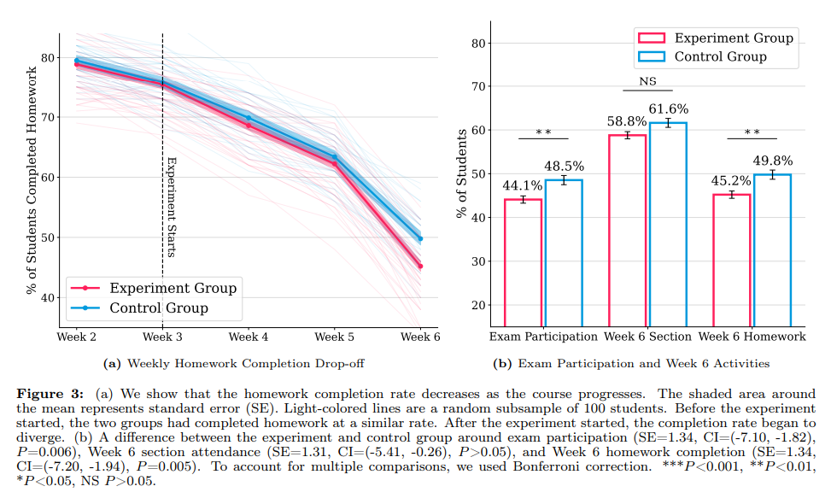
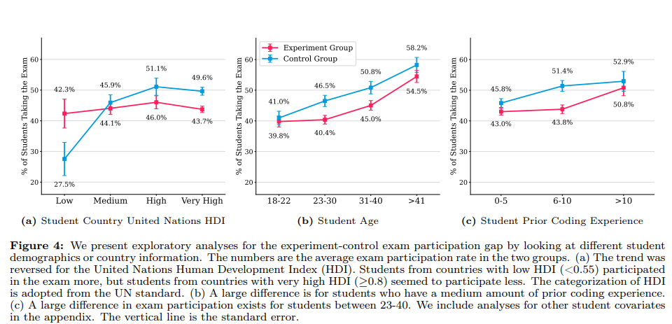
2. Literature Review
Nie et al. (2024)
  5,831 students over 146 countries finds no significant improvement on exams; instead ChatGPT use decreases engagement
Notes:
Nie et al. (2024) finds those who had no access to ChatGPT had an average exam score of 86.1. Those who had access to ChatGPT but did not use it had an average exam score of 86.6. Finally, those who had access to ChatGPT and did use it had an average exam score of 88.4. While this score is 1.8 points greater than those in the experimental condition that did not use ChatGPT and 2.3 percentage points higher than those in the control group, this difference was not statistically significant given the data that exists. The researchers do think that for those in the experimental group there could be a 6.86% increase for ChatGPT compared to non-ChatGPT users, but that is only valid at the 90% confidence interval (instead of the 95% confidence interval) and requires imputing missing data.
What the study did clearly show is the use of ChatGPT did decrease engagement in the course. The graph on the far left shows that students in the experimental and control group submitted homework in a manner that was not statistically significant. Within three weeks of introducing ChatGPT, students were statistically less likely to submit homework. They were also less likely to participate in exams. This despite no statistical difference in attendance rate of the groups. If we think engagement is key to learning (and retention) then the use of ChatGPT appears to decrease this activity.
The only positive is that students from low Human Development Index countries (HDI) were more likely to take the exam. The size of this sample, however, is too small. A t-test did not find this difference to be statistically significant. Furthermore, the trend regarding homework rates was similar between the general finding and all HDI samples.

Slide 7
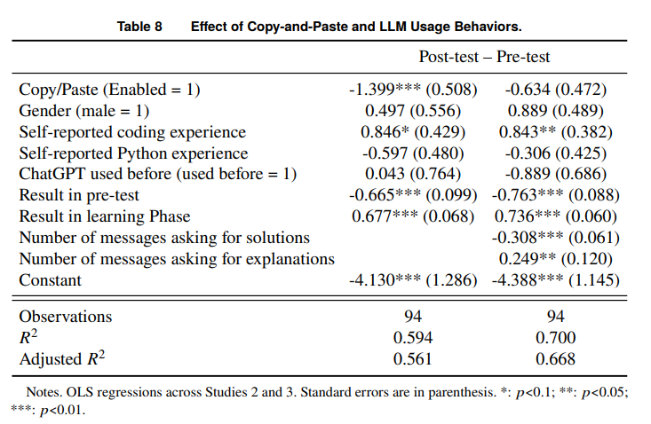
2. Literature Review
Lehmann et al. (2024)
  Observational data & experimental studies find
    Improved learning for explanations
    Decreased learning for solutions
    Overestimate learning
Notes:
Lehmann et al. (2024) continues to find evidence of this overall finding when look at students in computer coding classes. Students who use LLMs as a personal tutor, such as conversating about a topic and asking for explanations, see benefits from the usage. Students who use LLMs to solve practices exercises and do not invest mental effort suffer adverse effects. These studies find evidence of this in computer coding classes in the field. More interesting, these results are replicated in the lab due to an accidental experiment. In one experimental setting, the copy and paste function was not accessible. Thus, while some participants had ChatGPT use, they could not simply copy and paste questions into it. The researchers adjusted this in another experiment. This allowed the researchers to gain a better understanding of how the use of ChatGPT influences learning. In general, when copy-and-paste was included, learning decreased. Interestingly, when a variable coding the type of information posted in ChatGPT is included, it is seen those asking for solutions when there is copy-and-paste are who see the negative effect, while those asking for explanations can improve their learning in this setting. Finally, those who had access to LLMs overestimated their learning when compared to what they had actually demonstrated.

Slide 8
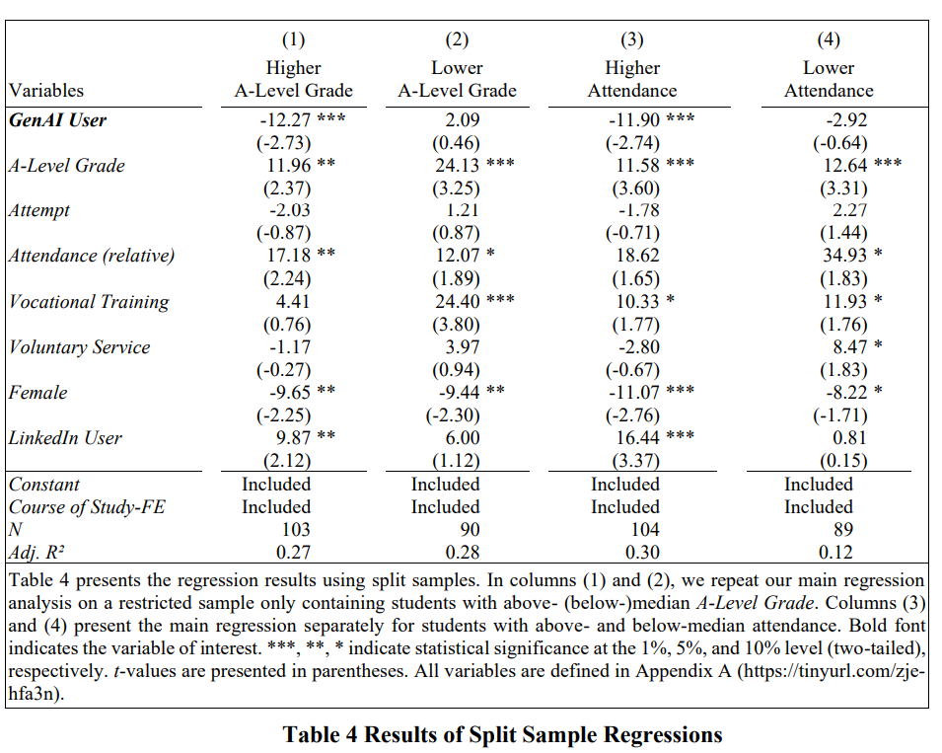
2. Literature Review
Weeks et al. (2024)
  GenAI decreases exam performance
  More pronounced for high performing students
Notes:
A sample of 193 students in an accounting course finds students who use GenAI when composing an essay (50% or more of the essay flagged as GenAI by ZeroGPT) score 6.71 points lower on their final exam than other students. Furthermore, through studying students who failed the course in the previous year (when GenAI was not available) the study finds that those who did not use GenAI saw a greater improvement in exam scores than those who did use GenAI. The study of European students also splits the sample by A-level grade students by those with the highest level of academic performance pre-university from those who are lower-level. It finds that GenAI use had a more substantive negative effect on these high performing students. A similar outcome came with attendance. Those who attended class at a high level and used GenAI saw a negative influence, while those with lower attendance did not see a statistically significant decrease. This is yet another suggestion that using GenAI engages in learning-hinderance rather than development.

Slide 9
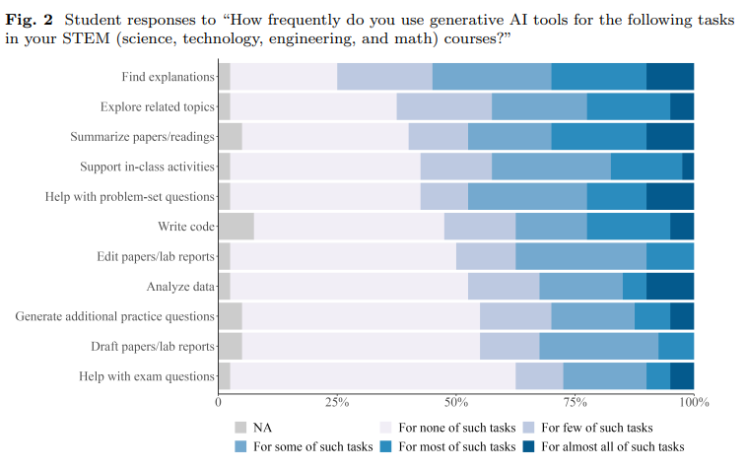
2. Literature Review
Wang et al. (2024)
  Students using GenAI is to save time and generate solutions
Notes:
While limited in its sample size, Wang et al. (2024) goes into the field to find that indeed, STEM students are primarily motivated to use Generative AI to save time, generate solutions, and skip the problem-solving process. Instead of using Generative AI as a tutor, most students use it as a way to summarize readings, find explanations, and get help (or solutions) to problem sets. This evidence adds to the literature of how students are using the tool when there are not guard rails.

Slide 10
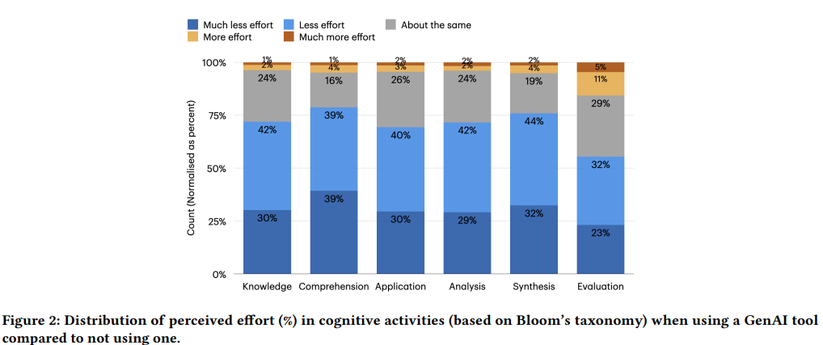
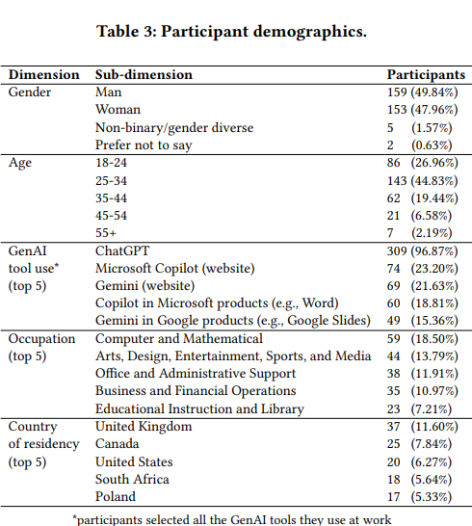
2. Literature Review
Lee et al. (2025)
  The use of GenAI decreases critical thinking in workers
Notes:
Lee et al. (2025) reached 329 knowledge workers through survey. Knowledge works are those who understand a body of knowledge and generate new information from that understanding that can improve the organization (Kidd 1994 - https://dl.acm.org/doi/10.1145/191666.191740). 18.5% of these workers were in the field of computers and mathematics. Another 13.79% were in the area of Arts, Design, Entertainment, Sports, and Media. 11.91% of the sample worked in Office and Administrative support. 10.97% of the surveys were completed by those in business and financial operations. The fifth largest sector was educational instruction and library with 7.21% of the sample.
This survey captured 936 real-world examples of tasks where GenAI was used in the workplace.
The study finds that while GenAI can improve worker efficiency, it can inhibit critical engagement with work and can potentially lead to long-term overreliance on the tool and diminished skill for independent problem-solving. Higher confidence in GenAI’s ability to perform a task is related to less critical thinking effort. When using GenAI tools, the effort invested in critical thinking shifts from information gathering to information verification; from problem-solving to AI response integration; and from task execution to task stewardship. Lee et al. (2025) conclude that knowledge workers face new challenges in critical thinking as they incorporate GenAI into their knowledge workflows. Mostly, critical thinking itself is in danger.

Slide 11


2. Literature Review
Summary
  The effect of GenAI depends on the intentions of the user
  GenAI decreases engagement, especially among high performers
  We overestimate the effect of GenAI in our learning
  Critical thinking is diminished in the workplace by GenAI
Notes:
Yes, GenAI has potential benefits. Systems like Khanmigo, which produce an GenAI that is bounded to be a tutor rather than a productivity tool, can help us learn. But we also have to reflect on the nature of human beings. I started today with the folklore of John Henry. What does John Henry teach us about human beings?
There is always a conflict between the humans and our techne. Is technology morally neutral or does technology contain morality within it? The myths of Daedalus suggest ancient science has one view understanding of this question. This view shapes our relationship to the machine. The fact-value distinction of modern science, however, suggests a different relationship between humans and the machines. The hammer has no inherit morality; it is only a fact. Value comes from things outside of modern science and its innovations. Although, one must wonder about this topic, as an innovation such as the atomic bomb raises the question if all technology is lacks inherent morality. Thus, perhaps we need to reflect more deeply on the relationship of humans and our techne.
Another theme of John Henery is pride vs. growth. Are we going to resist technology out of pride? This resistance will be death of us. Even the best of us can rage against the machine, but the result of this rage is our own death by our own hands. If we accept that growth is a necessity of life, then perhaps we can produce the best possible outcome of technological innovation.
At the same point, there does appear to be at least part of our nature, if not most of our nature, that accepts subjection and oppression. Rather than working to free ourselves from the caves that we reside in, we are happy to accept the projection of truth than seek truth itself. In many ways, GenAI is our version of Plato’s cave. Perhaps I’ve already said too much on this subject. Another setting might be a more appropriate place for this dialogue.
Some of us are apt to grab onto the latest piece of technology in the name of productivity. Others of us will resist and hold onto tradition until it can no longer held. What makes the steel drill and John Henry both problematic is they never investigate what does it mean to be a human?
We can’t answer that today, but the rest of this presentation will move forward on the premise that it is to live the examined life; it is to learn.

Slide 12

3. Analogy – The Calculator
ACAP
  Grade 2-5: non-calculators
  Grades 6-8: non-calculators & calculators
Notes:
Now one form of learning, which is just around the corner, is the Alabama Comprehensive Assessment Program – ACAP. This test provides us with a worthwhile analogy to think about GenAI, as I hear many say GenAI is just lie the calculator. So let’s accept this analogy. What does this analogy mean if we fully develop it? Well, if we look at the ACAP, we see that from Grades 2-5 calculators are not allowed. Even in grades 6-8, there are non-calculators and calculator sections

Slide 13

3. Analogy – The Calculator
ACAP
  Grade 2-5: non-calculators
  Grades 6-8: non-calculators & calculators
Why this difference?
Notes:
Why does the ACAP not allow calculators at first? Why does the ACAP continue to test students on material without a calculator?

Slide 14
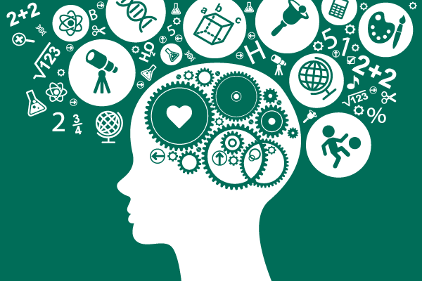
3. Analogy – The Calculator
ACAP
  Grade 2-5: non-calculators
  Grades 6-8: non-calculators & calculators
Why this difference?
  Foundation
Do students have a foundation in…
  …Accounting, Criminal Justice, Education, Geology, Kinesiology, Management, Nursing, Philosophy, Social Work, Theatre, … ?

Slide 15
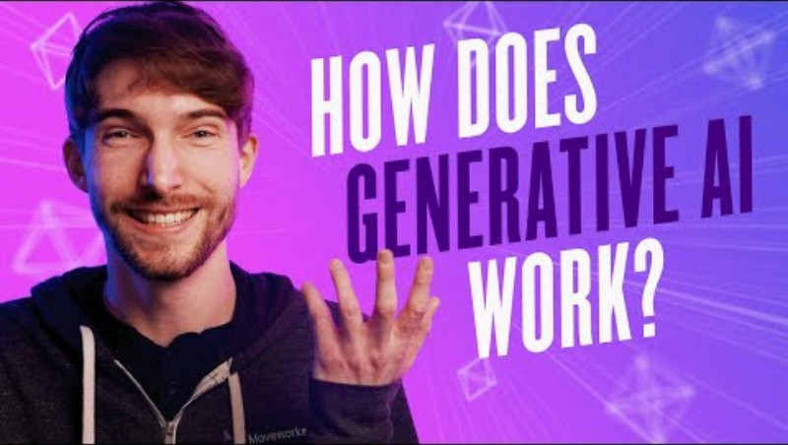
4. How to Outsmart GenAI
How does GenAI work?
Notes:
If the key is that we need to have a foundational knowledge before we can make a tool useful, what does this mean about the university and our students?
Do our students have a foundational knowledge of accounting, criminal justice, … or theatre? Even if we think of subjects like English, history, and mathematics, sure students took these subjects in high school, but do they have a foundational knowledge in the material we teach in these subjects?
So if our students lack the foundation, why are we giving them the tool when our application of the calculator has taught us that we need to build the foundational knowledge and skills before using a tool?

Slide 16
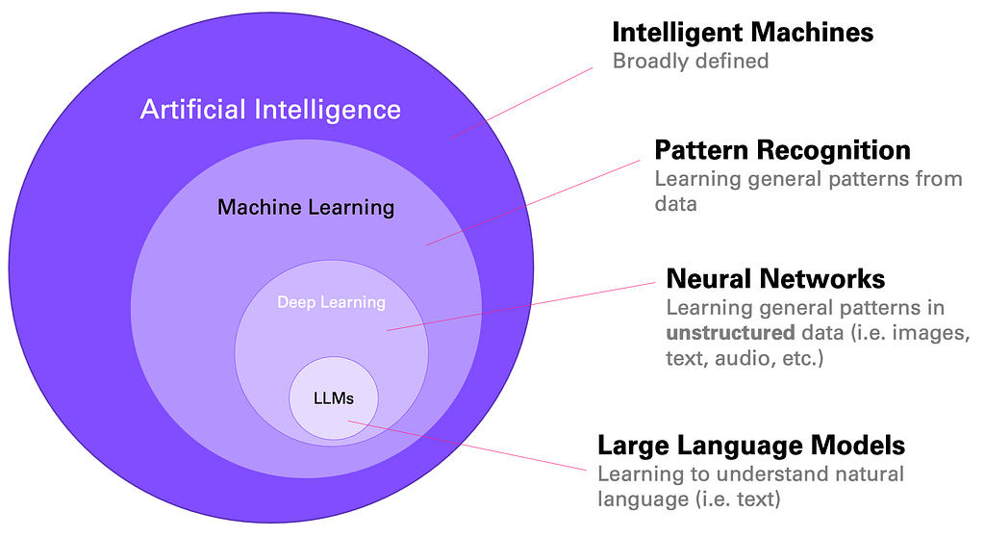
4. How to Outsmart GenAI
How does GenAI work?
  Data sources
    Books
    Newspapers
    Articles
    Websites
    Code repositors
    Social media posts
    Image descriptions
    Video transcripts
    Audio transcripts
Notes:
https://medium.com/data-science-at-microsoft/how-large-language-models-work-91c362f5b78f

Slide 17
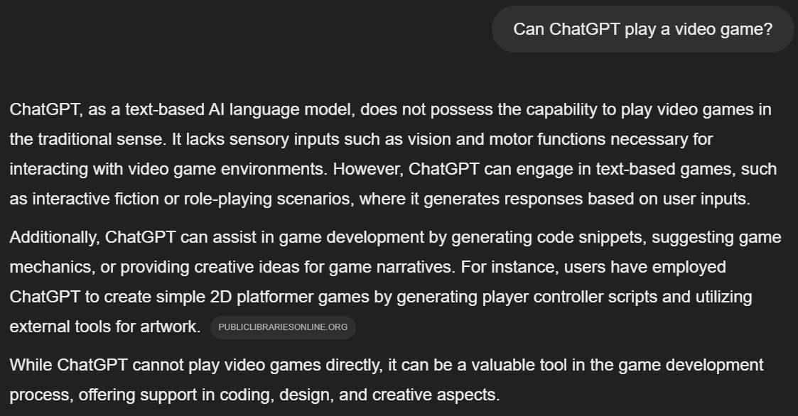
4. How to Outsmart GenAI
How does GenAI work?
  Data sources
    Books
    Newspapers
    Articles
    Websites
    Code repositors
    Social media posts
    Image descriptions
    Video transcripts
    Audio transcripts
  But look…

Slide 18

4. How to Outsmart GenAI
Video games as learning
  Scaffolding assessment
  Application of knowledge
  Analysis of actions
  Evaluation of game design
  Incorporates reflection and synthesis
  GenAI as a tutor

Slide 19
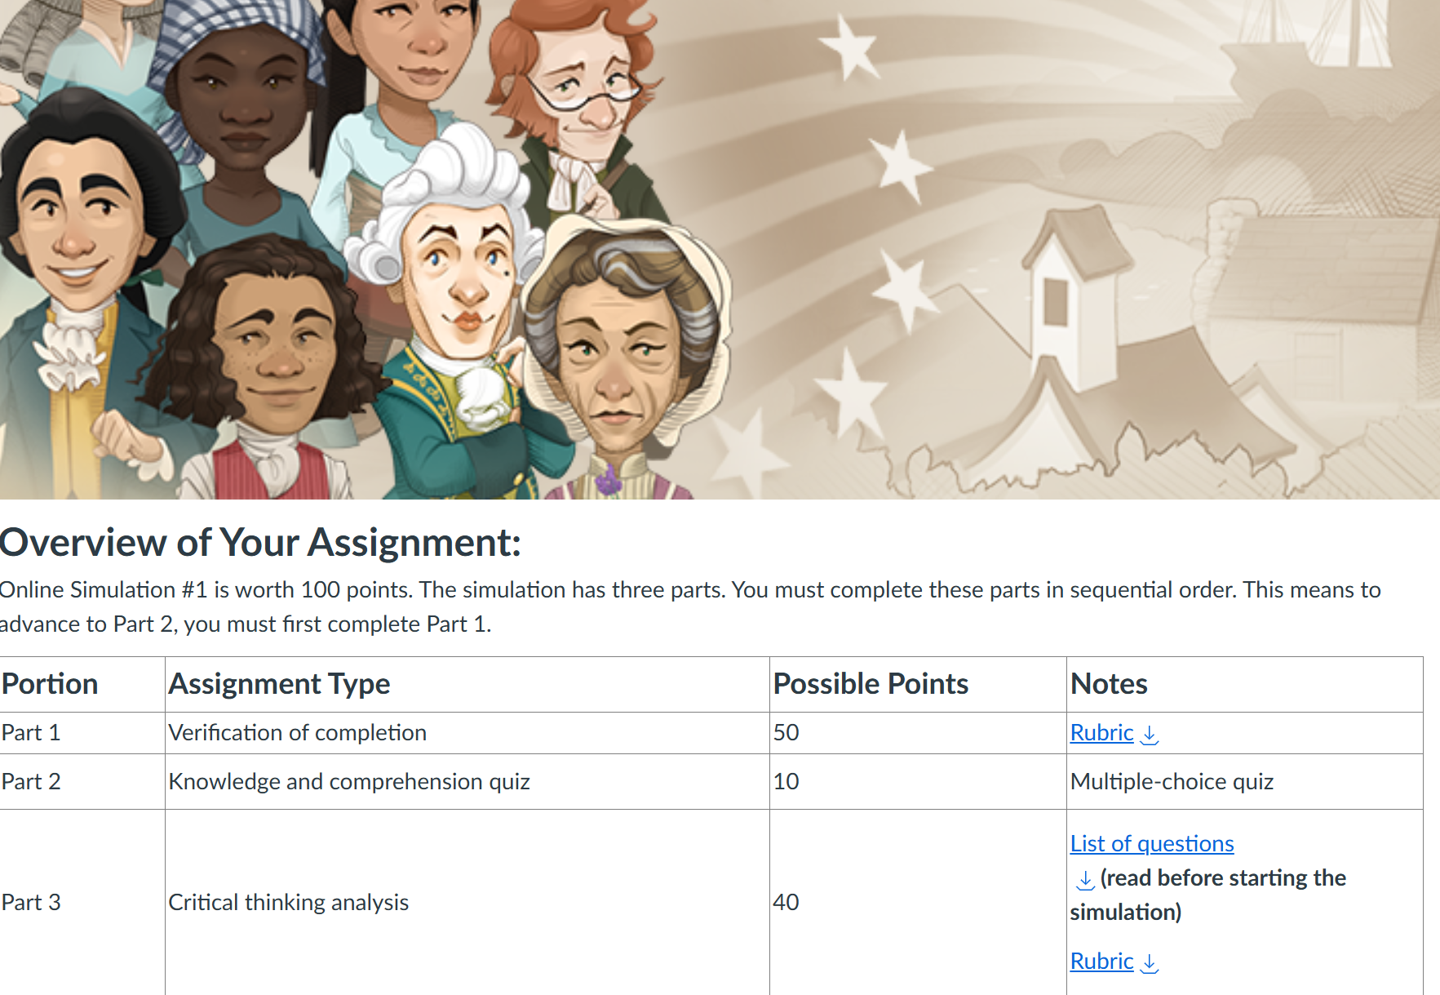
4. How to Outsmart GenAI
iCivics
  Verification of game play
  Assessment of knowledge and comprehension (remember and understand)
  Development of critical thinking

Slide 20
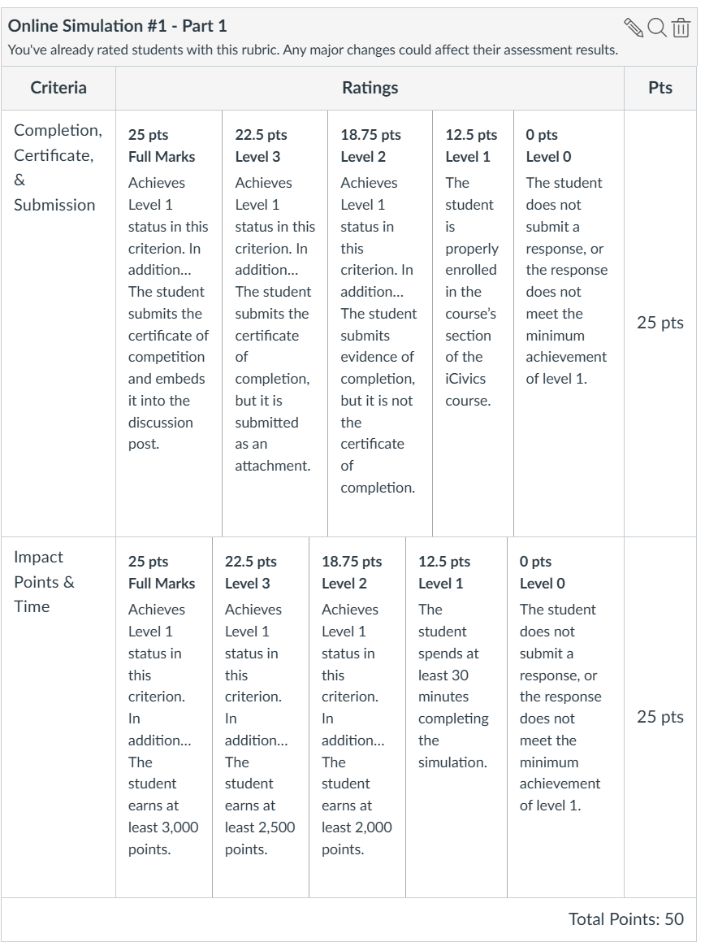
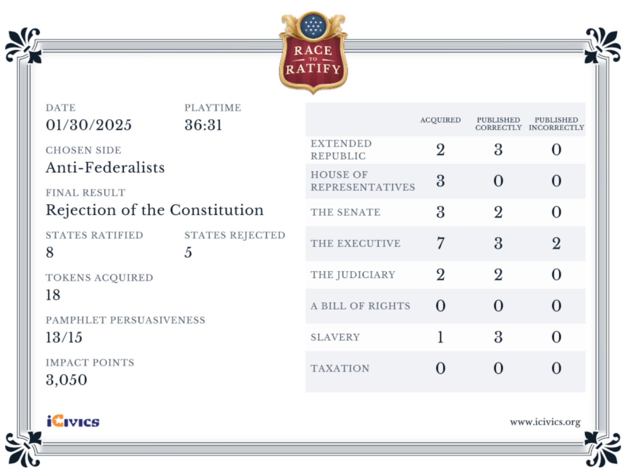
4. How to Outsmart GenAI
iCivics
  Verification of game play

Slide 21
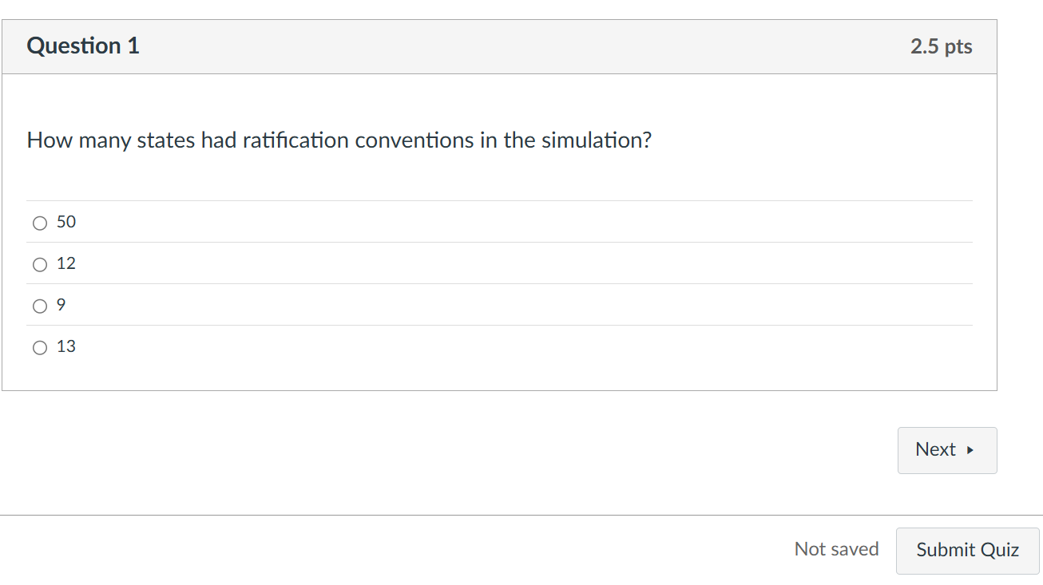
4. How to Outsmart GenAI
iCivics
  Assessment of knowledge and comprehension (remember and understand)

Slide 22
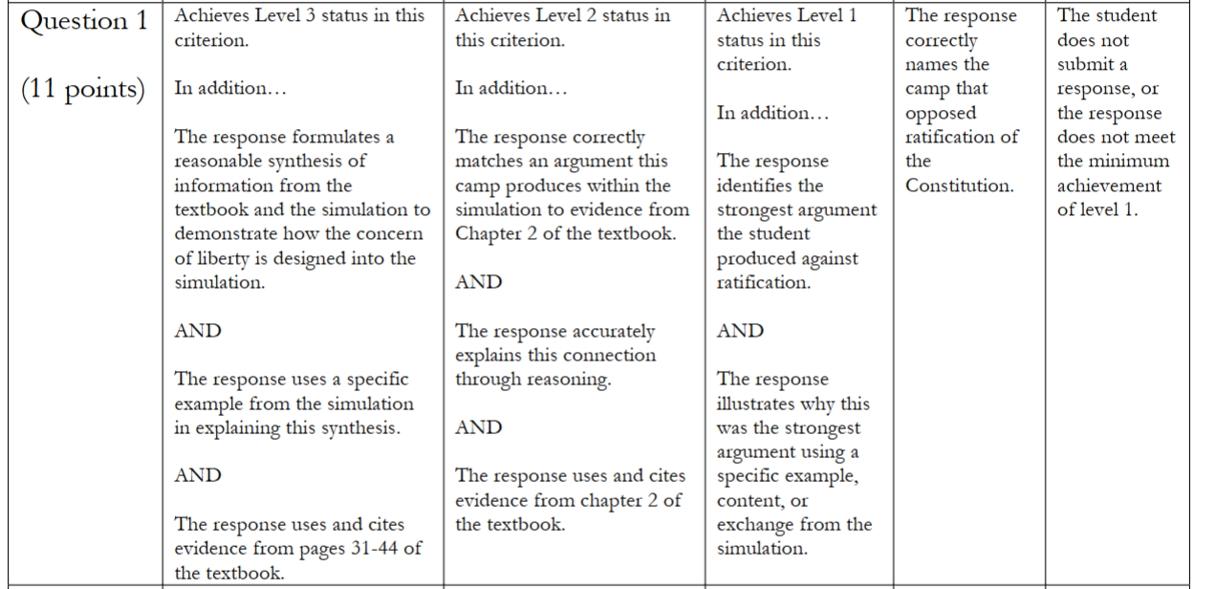
4. How to Outsmart GenAI
iCivics
  Development of critical thinking

Slide 23

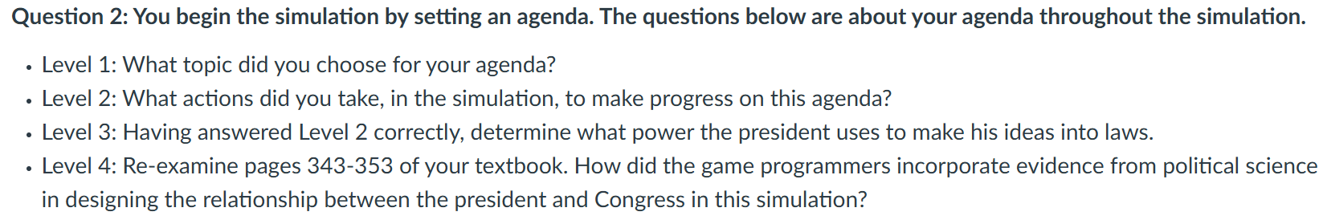
4. How to Outsmart GenAI
iCivics
  Development of critical thinking
    Example
Notes:
Five potential options are deficit reduction, education, energy, youth, health, or security.
What happens if we put this first question in ChatGPT?

Slide 24
4. How to Outsmart GenAI
iCivics
  Development of critical thinking
    Example
      ChatGPT: What topic did you choose for your agenda?
Notes:
Five potential options are deficit reduction, education, energy, youth, health, or security.
What happens if we put this first question in ChatGPT?

Slide 25
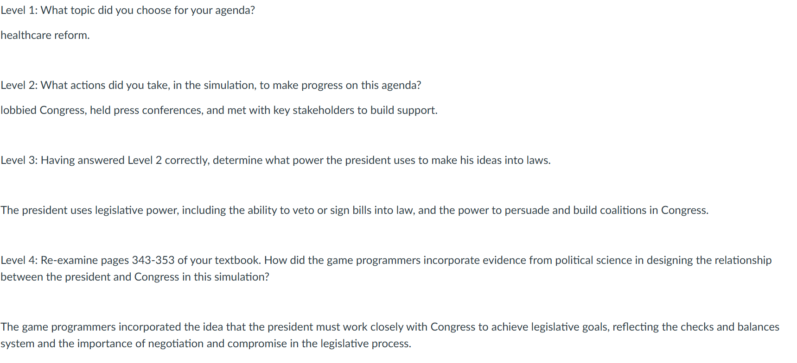
4. How to Outsmart GenAI
iCivics
  Development of critical thinking
    Example
      ChatGPT: What topic did you choose for your agenda?
Student T
Notes:
Five potential options are deficit reduction, education, energy, youth, health, or security.

Slide 26
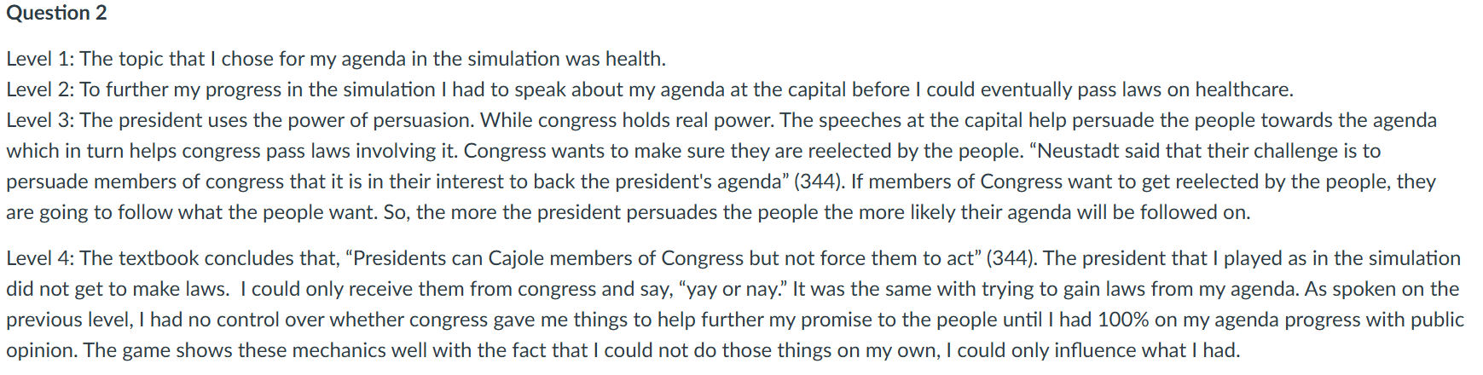
4. How to Outsmart GenAI
iCivics
  Development of critical thinking
    Example
      ChatGPT: What topic did you choose for your agenda?
Student P
Notes:
Five potential options are deficit reduction, education, energy, youth, health, or security.

Slide 27
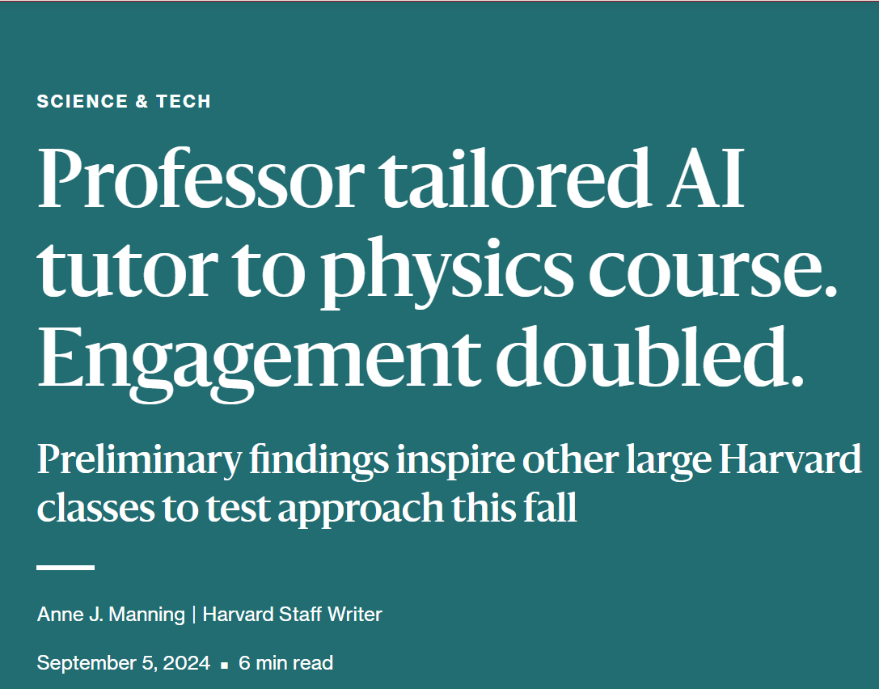
5. Utilizing GenAI as a Tutor
Today
  In-class discussion
  Question prompts
The future
  Training a tutor
    Guided by what it means to be a human…
Notes:
https://news.harvard.edu/gazette/story/2024/09/professor-tailored-ai-tutor-to-physics-course-engagement-doubled/

Slide 28
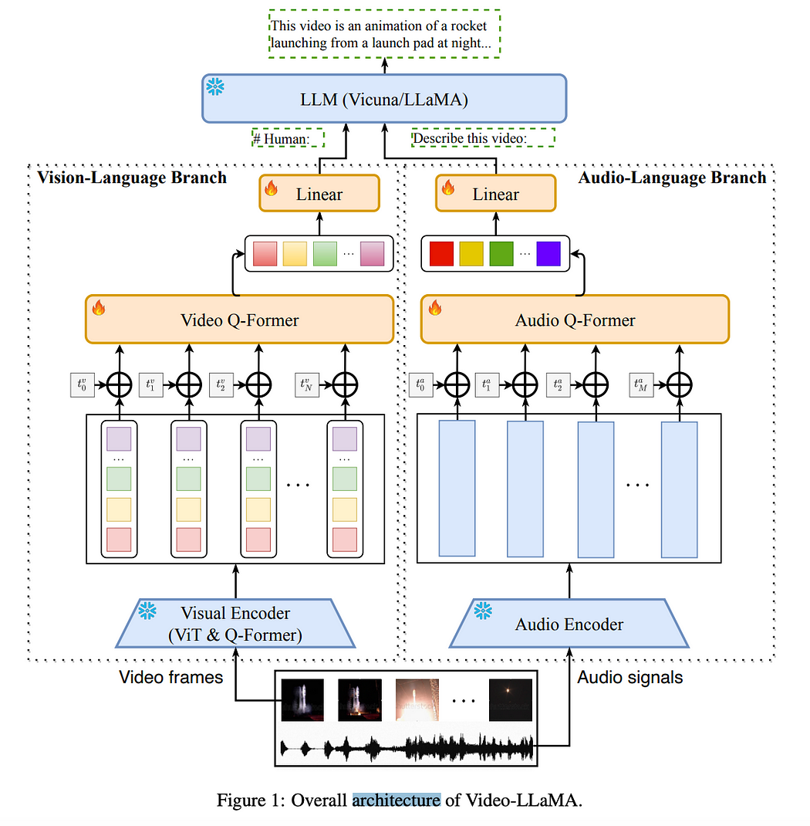
5. Utilizing GenAI as a Tutor
The (not) distant future
  GenAI improving with iCivics
  Some form of AI will play video games
    Video-LLaMA (Large Language Model Meta AI)
    Gallotta et al. (2024)
    Xiao and Yang (2024)
Notes:
https://medium.com/@satojkovic/paper-review-video-llama-9e78c65a112c
Research is finding that LLMs can already play games like Minecraft (due to a large amount of text existing on the game) and even games like Street Fighter. While there are technical challenges and this is in the infant stage, the solution I have today is not a long-term solution. It is only something that sort of works right now because it remembers the folklore of John Henry.
We shouldn’t ask our students to be the strongest person in the world, only to be worked to death to prove this. Other students, from more prestigious universities, are using these tools. Why handicap our students?
But we also can’t just use the machine. The literature already has the evidence of this common sense finding. Just using GenAI will subjugate, oppress, and dehumanize our students.
So we need to aim for the question of the folklore. What does it mean to be a human? If being a human means living the examined life, then continuing to find ways to invite our students to examine life is the gateway to education. The key for us is to find new manners to manifest this old invitation to the present moment.

Slide 29

Questions
Thank you!
Contact information
  Benjamin Gross
  bgross@jsu.edu
  x5651
  Associate professor of political science
  Director of Jax MIX
Notes:
https://medium.com/@satojkovic/paper-review-video-llama-9e78c65a112c
Research is finding that LLMs can already play games like Minecraft (due to a large amount of text existing on the game) and even games like Street Fighter. While there are technical challenges and this is in the infant stage, the solution I have today is not a long-term solution. It is only something that sort of works right now because it remembers the folklore of John Henry.
We shouldn’t ask our students to be the strongest person in the world, only to be worked to death to prove this. Other students, from more prestigious universities, are using these tools. Why handicap our students?
But we also can’t just use the machine. The literature already has the evidence of this common sense finding. Just using GenAI will subjugate, oppress, and dehumanize our students.
So we need to aim for the question of the folklore. What does it mean to be a human? If being a human means living the examined life, then continuing to find ways to invite our students to examine life is the gateway to education. The key for us is to find new manners to manifest this old invitation to the present moment.

