Slide 1


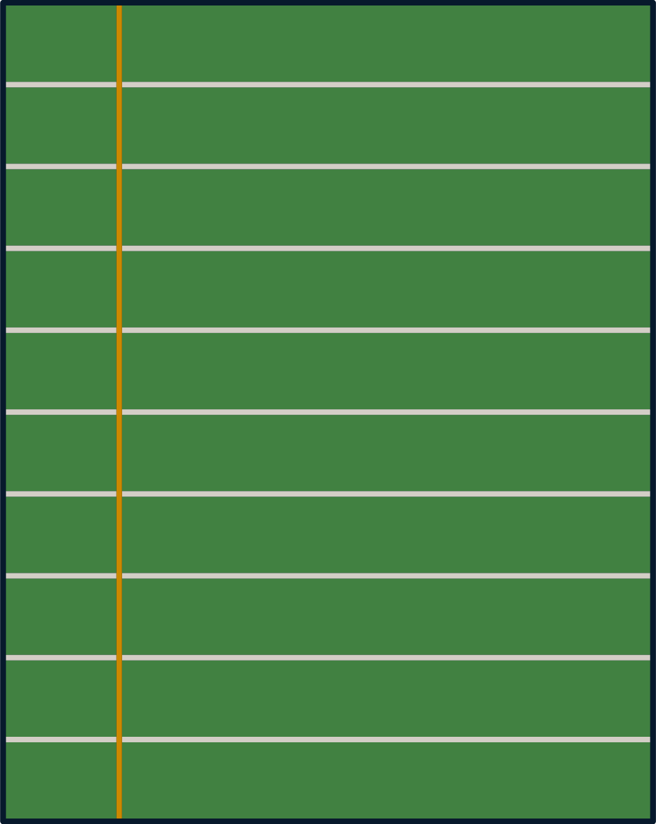

OER: Getting Started with Open Educational Resources
Part of President Killingsworth's OER Initiative at Jax State
DR. MARK SCIUCHETTI, INTERIM SENIOR DIRECTOR OF HONORS AND SPECIAL PROGRAMS,
ASSOCIATE PROFESSOR OF GEOGRAPHY
SEPTEMBER 3, 2024, 10:30 AM

Slide 2
Workshop Agenda
  1. What is OER?
  2. Benefits of OER
  3. Finding and Evaluating OER
  4. Integrating OER into Your Courses
  5. Overview of the OERS Certificate Program
  6. Q&A Session

Slide 3
1. What is OER?

Slide 4
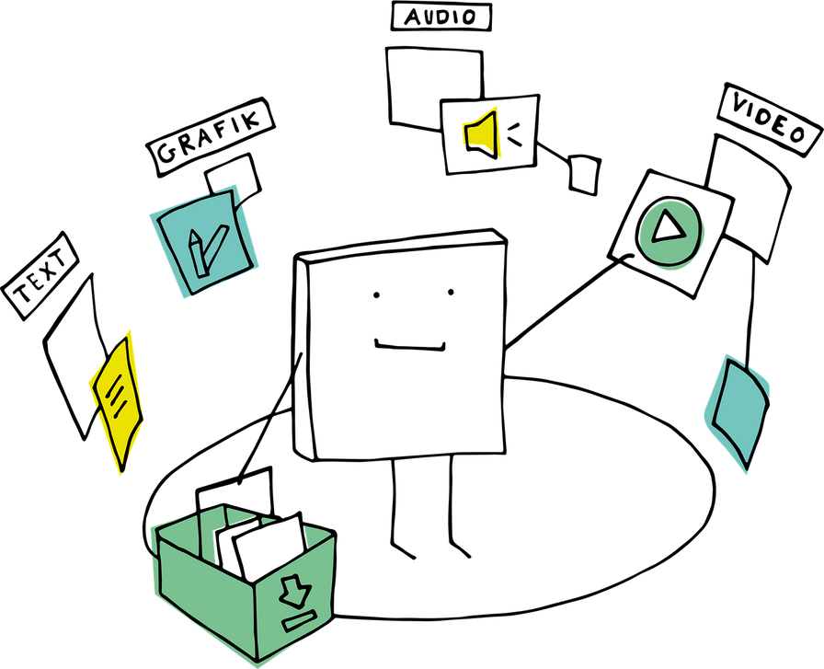
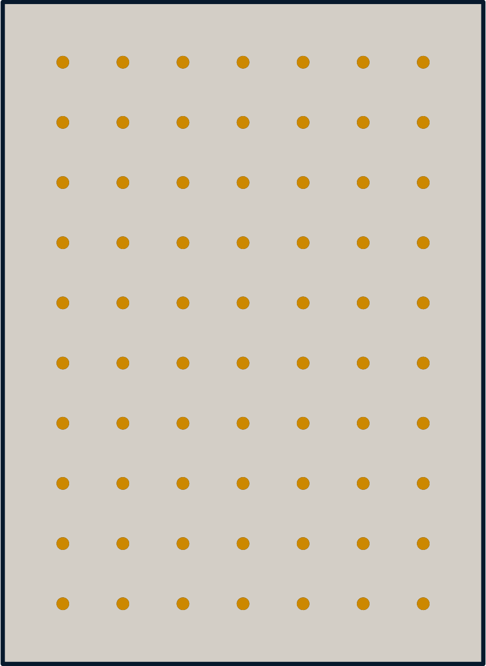
What are OER?
  Open Educational Resources are freely accessible, openly licensed materials that are useful for teaching, learning, and research.
  Importance: OER provide cost savings and flexibility in education.
"Access to education is a fundamental right for all."

Slide 5
Unlocking Educational Opportunities
Understanding Open Educational Resources
OPEN ACCESS
COLLABORATION
RESOURCES
Open access allows anyone to access quality educational materials without limitations or barriers.
Collaboration among educators fosters innovation and improves educational outcomes for diverse learners.
Resources enhance learning and provide accessibility for all students in various environments.

Slide 6

Licensing for OER
  Most OER are shared under Creative Commons licenses:
  - CC BY (Attribution)
  - CC BY-SA (ShareAlike)
  - CC BY-NC (Non-Commercial)
  - CC BY-ND (No Derivatives)
"Access to education is a fundamental right for all."

Slide 7
2. Benefits of OER

Slide 8



Benefits of OER
  Cost Savings: Reduces the financial burden on students.
  Flexibility/Customization: Allows educators to tailor materials to specific course needs.
  Access and Equity: Promotes equitable access to education for all students.
  Image: Visual representation of cost savings or educational access.
  Fosters innovation in teaching

Slide 9

Challenges of OER
  - Finding high-quality OER
  - Lack of awareness among educators
  - Time investment to adapt resources
  - Technological barriers in some cases

Slide 10
3. Finding and Evaluating OER

Slide 11

Types of OER
  - Textbooks
  - Full courses
  - Modules
  - Syllabi
  - Lecture notes
  - Assignments
  - Tests and quizzes
  - Audio, video, and multimedia

Slide 12

Finding OER
  1. OER Repositories: OERTX, MERLOT, OpenStax, OER Commons
  2. Institution-based platforms
  3. OER libraries from publishers
  4. Regional/national OER initiatives

Slide 13
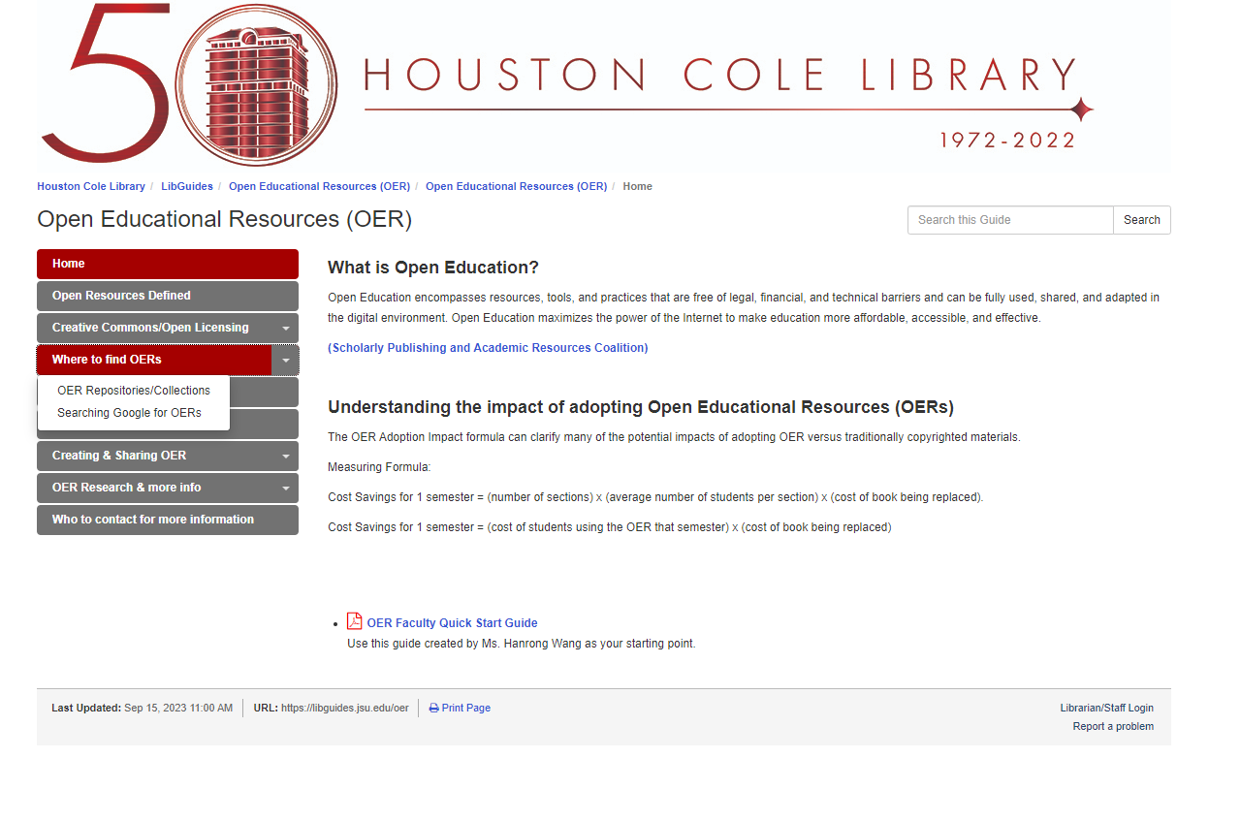
Finding OER
https://libguides.jsu.edu/oer
Notes:
https://www.merlot.org/merlot/index.htm
https://www.saylor.org/books/
https://openstax.org/subjects
https://open.umn.edu/opentextbooks
https://www.metmuseum.org/art/metpublications

Slide 14

Finding OER
    OpenStax (Rice Univ.) https://openstax.org
    Open Textbook Library https://open.umn.edu/opentextbooks
    In OER Repositories, you can find complete courses, lectures, videos, lesson plans, books and textbooks and pictures.
    Some Universities have courses dedicated to using OER - “Zero-Cost Textbook Alternatives” (http://guides.lib.jjay.cuny.edu/zerocost)
    Use Google: Click on “Settings” ->”Advanced Search”-> “Usage Rights”: Free to use, share or modify (Creative Commons License)
Notes:
https://jsu-my.sharepoint.com/:p:/g/personal/msciuchetti_jsu_edu/EXHAXd1MhHJBt3ymiGipz-wBYVT39hJK5d9jC0o0peQQ2g?e=Y8Ri6q

Slide 15
4. Integrating OER into Your Courses

Slide 16

Evaluating OER
  Criteria for evaluating OER:
  - Accuracy
  - Relevance to course objectives
  - Accessibility (ADA compliance)
  - Quality of content and design
  - Adaptability for your course

Slide 17



Adapting OER
  Tips for adapting OER to meet specific course needs:
    1. Revising content for accuracy and relevance
    2. Remixing multiple OER to create a comprehensive resource
    3. Localizing content to suit cultural or institutional contexts

Slide 18

Integrating OER into Courses
  Strategies for integration:
  1. Blending OER with existing course materials
  2. Using OER to create new course content
  3. Collaboration with colleagues to co-develop OER
  4. Engaging students in creating OER

Slide 19
OER Implementation
1. University-wide adoption of OER at a state universityvation and improves educational outcomes for diverse learners.
Examples of successful OER initiatives from other institutions:
2. A department-led initiative to replace traditional textbooks with OER
3. Collaborative OER creation between multiple institutions

Slide 20
5. Overview of the OERS Certificate Program

Slide 21


OERS Certificate Program
  The OERS Certificate provides:
  1. A comprehensive understanding of OER principles
  2. Tools for finding, evaluating, and integrating OER
  3. Leadership in OER adoption

Slide 22

Tools and Resources for OER
  1. Open Education Handbook (OER Policy.eu)
  2. Open Praxis articles
  3. OER Implementation Collection
  4. UNESCO OER documents
  5. Texas Higher Education OER portal

Slide 23
Future Trends in OER
  Discussion of emerging trends in OER:
  1. Open Pedagogy
  2. Use of AI in creating and adapting OER
  3. Increased collaboration across institutions
  4. Expanding OER into new disciplines and formats
Notes:
https://oertx.highered.texas.gov/courseware/24, https://certificate.mioer.org/, https://oerpolicy.eu/wp-content/uploads/sites/4/2017/07/Open-Education-Handbook.pdf, https://openpraxis.org/articles/10.5944/openpraxis.13.3.265, https://unesdoc.unesco.org/ark:/48223/pf0000215804, https://hnresearch.lonestar.edu/c.php?g=1206846&p=10110931, https://sites.google.com/northcarolina.edu/theoerimplementationcollection/home/oer-implementation-collection-modules/module-1-what-are-open-educational-resources.

Slide 24
Resources for Further Learning
  Additional resources for participants to explore after the workshop:
  1. Open Education Handbook (OER Policy.eu)
  2. Open Praxis articles
  3. OER Implementation Collection
  4. UNESCO OER documents
  5. Texas Higher Education OER portal

Slide 25
6. Q&A Session

Slide 26




Final Thoughts
As you conclude your journey with Open Educational Resources, challenge yourself to create an original resource that fills a gap in your teaching. Collaborate with peers, share your creation, and reflect on how it enhances learning environments for your students.

Slide 27
Mark Sciuchetti
Thank you!
OERS Certificate forth coming!!
msciuchetti@jsu.edu

