Slide 1
Jacksonville Association of Nursing Students (JANS)
Connect with us on our social media platforms!
Facebook: Jacksonville Association of Nursing Students
Instagram: @jansatjsu
Twitter: @jansatjsu

Slide 2
What is JANS?
Why should you join?
JANS is a student-led organization that plans programs for the student body, along with projects that help serve our campus community. JANS also sends representatives to the state convention of the Alabama Association of Nursing Students each year. At convention, student nurses have the opportunity to work together to improve the profession of nursing and enrich their own personal careers. JANS also raises money for local and national philanthropic organizations.
As a member, you are also part of the Alabama Association of Nursing Students and the National Student Nurses Association. You are connected to over 50,000 students!
Becoming involved can open many doors throughout your professional career. Leadership looks great on resumes!
As a member, you are eligible for scholarships that are awarded exclusively to JANS members.

Slide 3
How do you join JANS?
Membership is extended to new students on orientation day.
Membership dues are $55 for ONE YEAR and $85 for TWO YEARS.
  Please NOTE: Dues are subject to change based on national increases.
  We accept cash or check for dues. All checks should be made payable to JANS.
Link to Application: JANS 2020-2021 Membership Application.docx
Print and fill out this application to turn in with your dues.
    Please NOTE: The application has a space for credit/debit card payment for dues. We do NOT accept credit/debit cards for dues.
  Due to COVID-19, please mail your application and payment to Dr. Duckett at the address below:
    Jacksonville State University
    School of Health Professions and Wellness
    Department of Nursing, JANS
    700 Pelham Road North
    Jacksonville, Alabama 36265

Slide 4
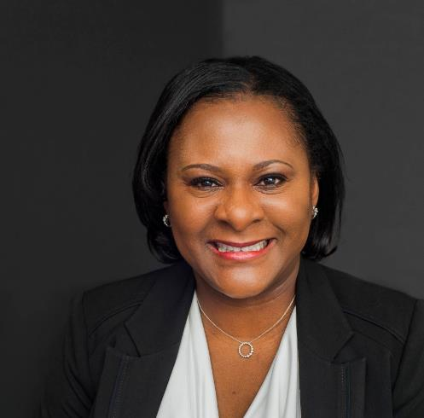
Meet the Advisors
Dr. Missy Duckett, DNP, MSN, RN, CCRN
Dr. Oye Akisanya, Ph.D., MSN, RN, PHCNS
Dr. Duckett graduated from Jacksonville State University with her BSN in 1993 and returned to JSU to complete her MSN and DNP. She worked in critical care for 20 years and maintains certification in critical care nursing. She currently teaches NU 325 (Adult Health in Secondary and Community Settings). She also teaches in the RN to BSN program and the graduate nursing program. Dr. Duckett has been JANS faculty advisor since 2014.
Dr. Akisanya has worked in acute and long-term care, primary care, and public health settings since 1997. She currently teaches NU 311 (Foundations of Nursing Practice) and select courses in the STEP, MSN, and DNP programs at Jacksonville State University. She is also serving as the Health Officer on the COVID-19 Task Force at JSU. Dr. Akisanya has been JANS faculty advisor alongside Dr. Duckett since 2014.

Slide 5
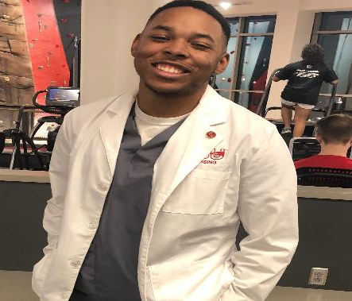
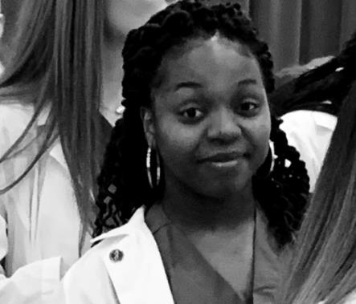
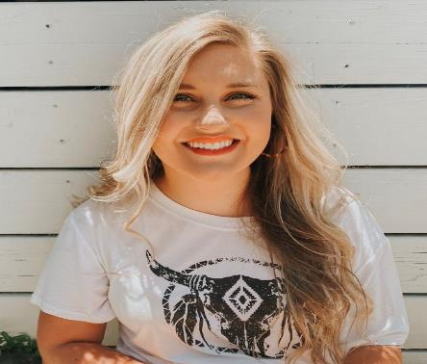
Meet the Officers
President – Christina Wilson
Vice President – Craig Scott, Jr.
Secretary – Harlin Hodges
Christina serves as the president of JANS. She is from Douglasville, Georgia, but she currently resides in Carrollton, Georgia. She joined JANS as a way to fellowship and connect with other nursing students like herself. Her special interest in nursing is pediatrics. Christina hopes to eventually work at Children’s Healthcare of Atlanta and with children who have cancer.
Harlin serves as the secretary of JANS. Harlin is a fourth semester nursing student from Roanoke, Alabama. She joined JANS to interact with students from different cohorts and to be surrounded by a support system that pushes her to be a better nurse in the future. Harlin hopes to work in labor and delivery and pursue a master’s degree in the future.
Craig serves as the vice president of JANS. He is excited to adapt to our new normal and enhance the lives of present and future student nurses. Craig plans to become a pediatric nurse (male nurse) to care for anyone, anytime, and anywhere. Craig says, “Stay Cocky, and Go Gamecocks!!”

Slide 6
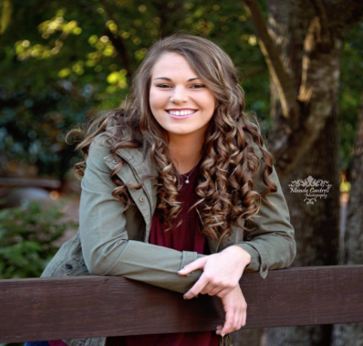
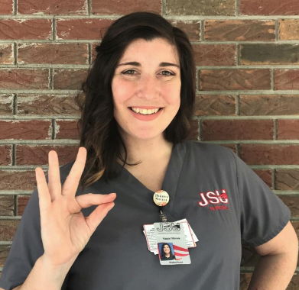
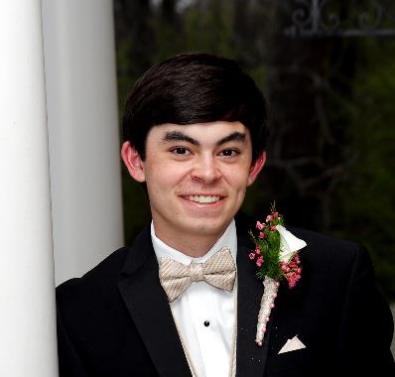
Meet the Officers
Treasurer - Gracie Federer
Communications - Kassie Tillbrook
Project Manager - Hunter Watts
Gracie serves as the treasurer for JANS. She is from Bremen, Georgia. Gracie joined JANS because of the great opportunities it provides: leadership, networking, scholarships, fundraisers, community service, and conventions. Gracie plans to spend her first few years as an ICU nurse. She is also interested in geriatrics. Gracie plans to attend graduate school in the future.
Kassie serves as the communications officer for JANS. She is from Huntsville, Alabama, but she was born in Las Vegas! She joined JANS as a way to meet fellow nursing students. Through JANS, Kassie has met some of the best people to share the same success and struggles with as she navigates through the program. Kassie would like to become a Certified Wound Specialist eventually.
Hunter serves as the project manager for JANS. He is from Alexandria, Alabama. Hunter joined JANS to connect with other nursing students and gain leadership skills for the future. Hunter’s special interest in nursing is critical care or emergency medicine. He plans to obtain his master’s or doctorate in nursing to become a nurse practitioner or nurse anesthetist in the future.

Slide 7
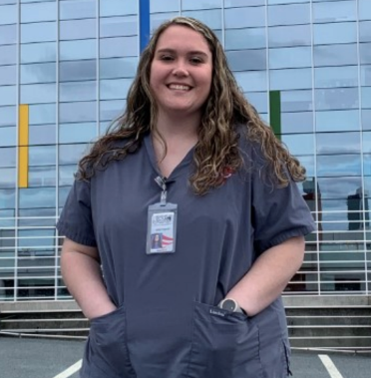
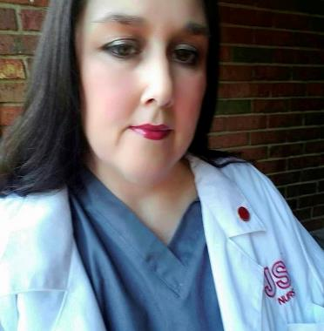
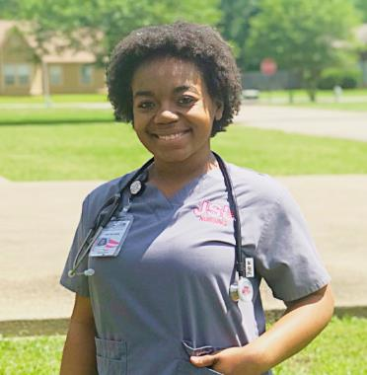
Meet the Officers
Publicity Chair – Jordan Fitzgerald
Social Media – Jolie Campbell
Event Planner – D’Che McLaurin
Jordan serves as the publicity chair for JANS. She is from Pinson, Alabama. Jordan joined JANS because it allowed her to meet other nursing students and create forever relationships. She said, “JANS is a good way to get yourself involved because it’s other fellow nursing students that understand the struggle of being a nursing student.” Jordan has an interest in labor and delivery nursing.
Jolie serves as the social media chair for JANS. She is from Wellington, Alabama. Jolie joined JANS to connect with other nursing students and to participate in organization-sponsored activities, such as community outreach and education. Her special interests in nursing are mother/baby, wound care, and infectious disease.
D’Che serves as the event planner for JANS. She is a second semester nursing student from Laurel, Mississippi. She likes JANS because of the opportunities to help better serve our communities. D’Che plans to work in the neonatal intensive care unit (NICU) post-graduation.

Slide 8
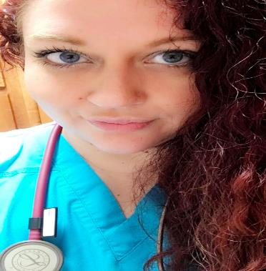
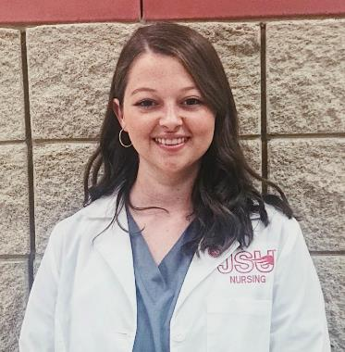
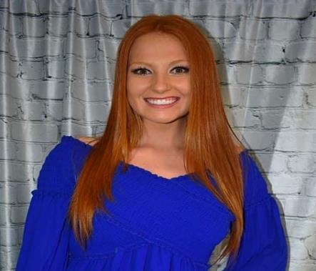
Meet the Officers
Membership – Gabriel Page
Membership – Mackenzie Pope
Membership – Denise Smith
Gabriel serves as a membership officer for JANS. She is from Anniston, Alabama. Gabriel joined JANS to become involved with her nursing school community. She said, “I want to be an influence to others and help anyone I can.” Gabriel wants to work in the ED or OR while getting her MSN to become a FNP. She would like to open her own practice.
Mackenzie serves as a membership officer for JANS. She joined JANS for the opportunity to meet new people and to become more involved with the nursing program at JSU. Mackenzie plans to work on a medical-surgical unit to gain a solid foundation before returning to JSU to become a nurse practitioner. She has a special interest in oncology and would love to work in oncology.
Denise serves as a membership officer for JANS. She is from Lincoln, Alabama. Denise joined JANS because of all the amazing opportunities and benefits. She said, “I love JANS, and I’m so thankful for the friendships I’ve made so far.” Denise wants to be come a pediatric oncology nurse or a labor and delivery nurse and plans to further her education to be come a nurse practitioner.

Slide 9
COVID-19’s Impact on JANS
As COVID-19 continues to impact Jacksonville State University, JANS, like all other organizations, will not be able to host some of our annual events.
Typically, JANS hosts:
  A Fall-In to welcome back nursing students to the Fall semester,
  A Spring-Out to mark the ending of the Spring semester,
  A Pre-Nursing Social for students who are interested in JSU’s Nursing Program,
  AND many other great events!
  However, JANS will still be participating in service projects that can be done with minimal to no contact. JANS may also try to plan some virtual events to connect with nursing students. Be on the LOOKOUT for more information!

Slide 10
Questions?
NAME | POSITION | SEMESTER | EMAIL
Dr. Missy Duckett | Advisor | FACULTY | mduckett@jsu.edu
Dr. Oye Akisanya | Advisor | FACULTY | akisanya@jsu.edu
Christina Wilson | President | 3rd | cwilson17@stu.jsu.edu
Craig Scott, Jr. | Vice President | 4th | cscott9@stu.jsu.edu
Harlin Hodges | Secretary | 4th | hhodges1@stu.jsu.edu
Gracie Federer | Treasurer | 3rd | gfederer@stu.jsu.edu
Kassie Tillbrook | Communications | 3rd | ktillbrook@stu.jsu.edu
Hunter Watts | Project Manager | 3rd | hwatts2@stu.jsu.edu
Jordan Fitzgerald | Publicity Chair | 4th | jfitzgerald@stu.jsu.edu
Jolie Campbell | Social Media Chair | 3rd | jsu5795b@stu.jsu.edu
D’Che McLaurin | Event Planner | 2nd | dmclaurin@stu.jsu.edu
Gabriel Page | Membership | 2nd | jsu0397p@stu.jsu.edu
Mackenzie Pope | Membership | 3rd | mpope1@stu.jsu.edu
Denise Smith | Membership | 3rd | dsmith34@stu.jsu.edu

Slide 11
CONGRATULATIONS
on your admission to upper division nursing at Jacksonville State University!
We are proud of you and look forward to working with you as you begin this new journey. Let us know if we can help you in any way!
-Your 2020-2021 JANS Faculty Advisors & Officers

