Slide 1
The Efficacy of Homework in
Physical Education
A review of Literature:
Example Presentation for Master’s Comprehensive Exam Defense
By Kory Hill, Spring 2016

Slide 2

Debate
The perceived value of homework has been influenced by political events (Gill & Schlossman, 2004; Maltese, Tai, & Fan, 2012).
The debate continues today. See Alfie Kohn vs Harris Cooper (“Educational Leadership: Responding to Changing Demographics:The Case For and Against Homework,” n.d.).
Homework has not been viewed an important tool and in physical education and thus rarely studied (Mitchell et al., 2000; van Sluijs, McMinn, & Griffin, 2007).

Slide 3
Why?
Physical educators have suggested homework as a means of promoting PA outside of class and freeing up class time for PA and motor skill acquisition (Hill, 2009; Novak & Lynott III, 2015; St. Ours & Scrabis-Fletcher, 2013).
Health promotion professionals report that many of the characteristics and outcomes of homework are likely to increase physical activity; PA is increased when there is:
parental involvement
choice
encouragement of extracurricular participation
acquisition of motor skills
(Baranowski et al., 1997; Enright & O’Sullivan, 2010; Strong et al., 2005).

Slide 4
Literature Search
Three databases were searched for the years 2000-2016. In Google Scholar the words homework and physical education were used in a title search. When using SportDiscus and ProQuest, the same terms were used in abstract search.
  Google Scholar: 21 returns
  SportDiscus: 21 returns
  Proquest: 83 returns
Excluded:
  Non-PE
  Exclusive to students with disabilities
  Secondary Sources
  Multiple approach interventions
Reviewed: 17 Primary Sources identified

Slide 5
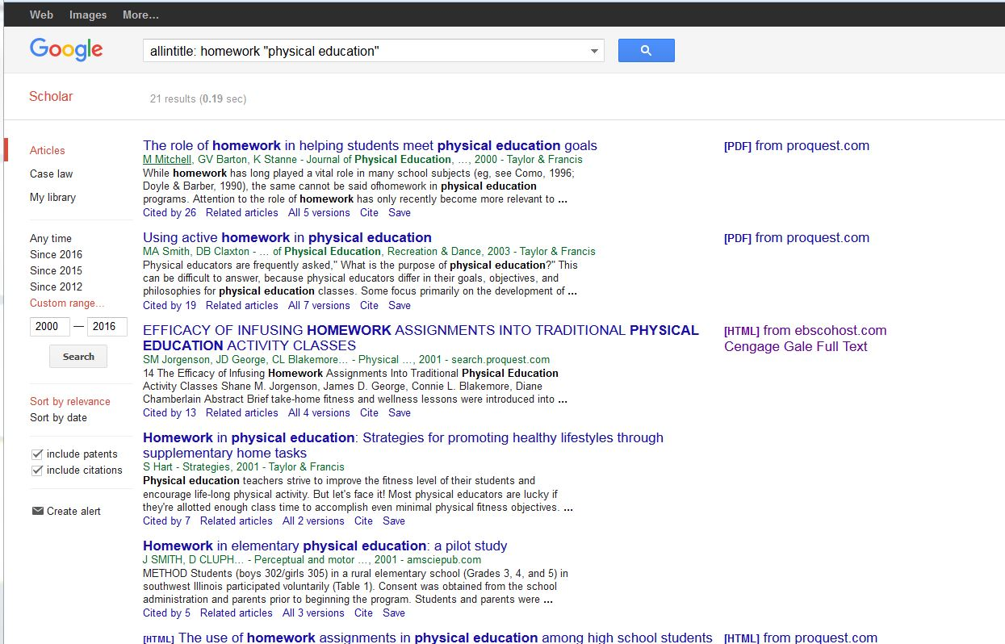
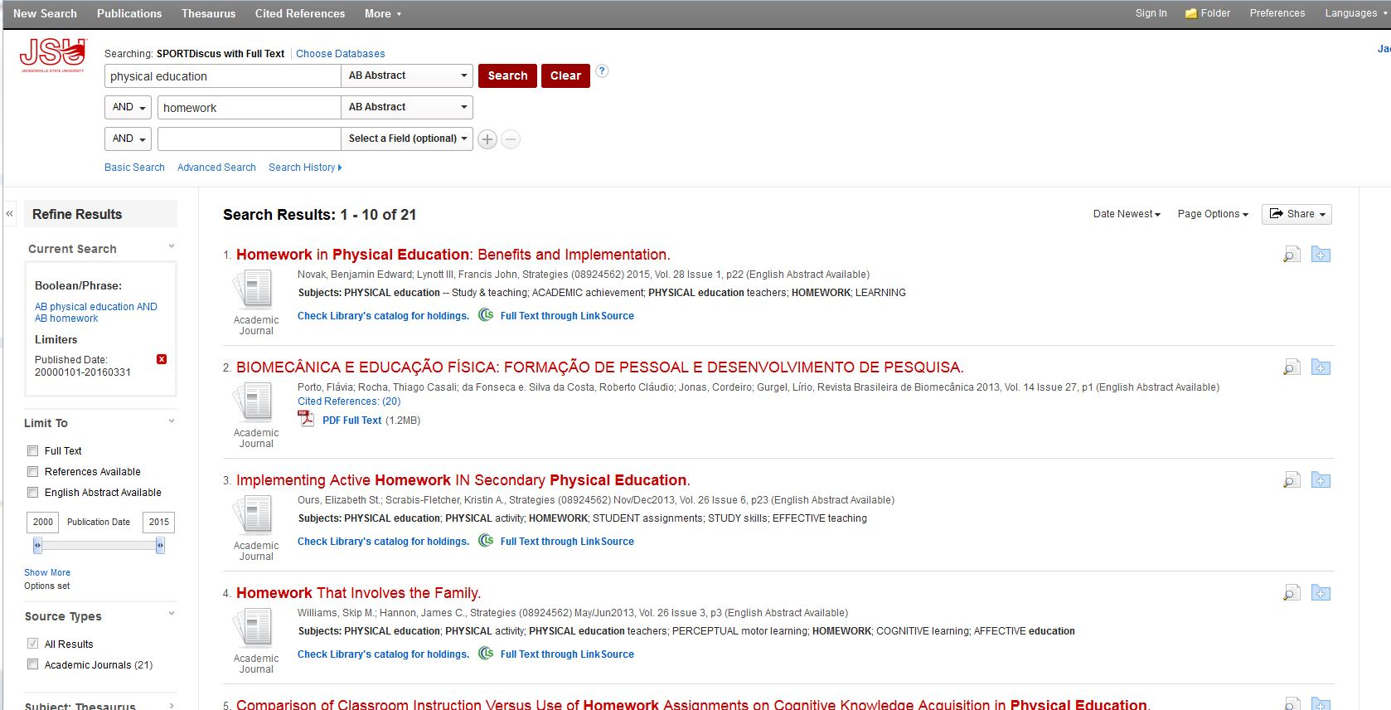
Screen captures

Slide 6
Homework for the cognitive Domain
Williams et al., 2013:
  H.S. (N= 175) mm strength/endurance preparation homework
  DV=written test, IV=trt (lecture, hw only, lecture + hw)
  All groups had equal levels of comprehension on post test
Heesch et al., 2006:
  Sedentary Adults(N=244) taught cognitive strategies for increasing PA.
  DV=Process of change, self efficacy, Pros/Cons, IV trt (homework + pedometers)
  Those completing the homework were more likely to have higher POC and self-efficacy scores.
Jorgenson & George, 2001:
  College students (N=291) in activity classes with infused fitness knowledge.
  DV=written test on fitness knowledge, IV=treatment (HW vs control)
  HW group had sign. Improvement on test
Jenkins, 2006:
  College students (N=157) in activity classes with infused fitness knowledge.
  Qualitative design. 20% comments were HW+, 11% comments were HW-

Slide 7
Physical Activity and fitness Behaviors
Increases PA
  Duncan et al., 2011:
  New Zealand 5th and 6th graders ( N=97)
  Pre-post school based intervention with homework
  Increase in PA as measured by pedometers
  Fairclough et al., 2013:
  4th and 5th grade British children (N=318)
  Pre-post cross-curricular school based intervention with homework
  Treatment group showed a decrease in BMI & MPA as assessed by activity log; girls and obese students benefited most.
  Kriemler et al., 2010:
  Swiss 1st and 5th graders (N=802)
  Pre-post intervention that included homework
  Students in the treatment group showed increases in skinfold measures and MVPA as measured by accelerometer
  Claxton & Wells, 2009:
  U.S. University students (N=201) in wellness course.
  Pre-post homework only intervention
  Treatment group showed increase in mm strength and endurance activity and weight management activity; no difference in total PA as measured by activity log

Slide 8
Teachers and parents Attitudes and Practices
Teachers
  Mitchell et al., 2000:
    80% of U.S. in-service PE teachers (N=54) gave HW
    Mostly written and for make up work
  Micheal et al., 2006
    Part of CDC’s SHPPS
    Representative sample (1194) of k-12 PE teachers in all 50 states
    31% gave homework that involved the whole family
  Thom & Yun, 2012
    Multiple regression identified three factors that influence decision to give PE homework: knowledge, attitude, expectations
  Burt et al., 2013
    17% of PE teachers (N=144) reported giving homework
Parents
  Piech et al., 2013
    Preschooler in Poland (N=38) given homework (PA and play) to do with parents.
    32% did not do the HW with children (66%-no time, 25%-not willing, 8%-forgot)
  Pantanowitz et al., 2011
    95% of Israeli high school parents support the use of HW in PE

Slide 9
Students Attitudes and Practices
Perceptions of the use of HW as a learning tool in PE:
  54% H.S. students support
  83% of H.S. view it as inappropriate
  Interviews showed HW was a major factor in curriculum resistance
  Qualitative data revealed students believe HW does not belong in PE – not a “real class.”
  College students comments on HW for PE activity class: 65% positive and 35% negative.
Complete HW assignments:
  53% H.S. students did none
  3-5 graders – 22% completion by boys & 32% completion by girls
  Roughly 52% of HW submitted by H.S. students
  Only 6.9 % on PA homework was independent (teams, family, friends)
  Falsification of PA logs is common
  Low completion rates when not graded
(Barney & Strand, 2008; Jenkins, Jenkins, Collums, & Werhonig, 2006; Kinchin & O’Sullivan, 2003; Kriemler et al., 2010; Pantanowitz, Lidor, Nemet, & Eliakim, 2011; Smith, Cluph, & O’connor, 2001; Smith & Madden, 2014)

Slide 10
Conclusions
Support of Best Practices
  Accountability
      (Gabbei & Hamrick, 2001; Mitchell, Barton, & Stanne, 2000; Novak & Lynott III, 2015; St. Ours & Scrabis-Fletcher, 2013a)
  Family
      (Baranowski et al., 1997; Faber, Hodges Kulinna, & Darst, 2007; Williams & Hannon, 2013)
  Tied to objectives
      (Novak & Lynott III, 2015; Williams & Hannon, 2013)
  Teach others
      (Cutforth, 2000; Hill, 2009)
  Choice
      (Enright & O’Sullivan, 2010; St. Ours & Scrabis-Fletcher, 2013b)

Slide 11

Conclusions
Possible future research:
  Motor skill homework?
  Non health & fitness-related cognitive content?
    Sports rules and strategies
    Biomechanics
  What is the appropriate amount of Homework?
  Technology vs pen & paper for tracking PA?

