Slide 1
Jax MIX
Merging, Innovation, & eXperience
A signature general education program

Slide 2
Table of Contents
3
4
5
6
7
8
9
10
11
12
13
14-16
17
What is General Education?............................................
What is Jax MIX?................................................................
Requirements in Jax MIX.................................................
Pathways Explained............................................................
How to Earn a Focus in a Pathway.....................................
Events Explained................................................................
Work Product and MIX Course Explained.................
Microcredentials Explained .............................................
Steps to Earning a Microcredential.....................................
Benefits...................................................................................
Jax MIX Resources.............................................................
Why should I visit Credentials?.......................................
Adding your personal email.................................................

Slide 3
What is General Education?
Common Answers
“Core Classes”
“Basics”
“Required Courses before your Major”
Back to Table of Contents

Slide 4
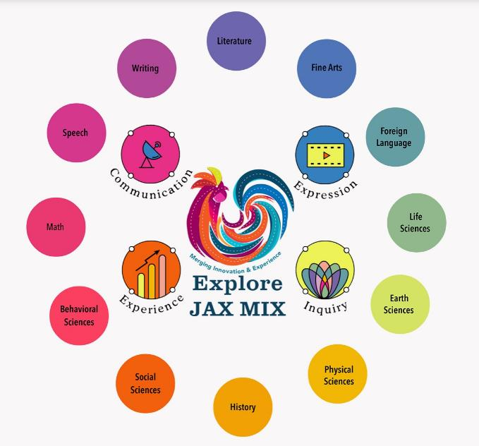
What is Jax MIX?
Jax MIX is Jax State’s general education program
Mission: Develop the human first by investigating the human condition that is common to all of us before we depart on our individual paths of vocational training.
Back to Table of Contents

Slide 5
Jax MIX=General Education
Jax MIX’s courses are split into 4 emphasis areas. You are required by the state to complete these hours within Jax MIX.
Back to Table of Contents

Slide 6
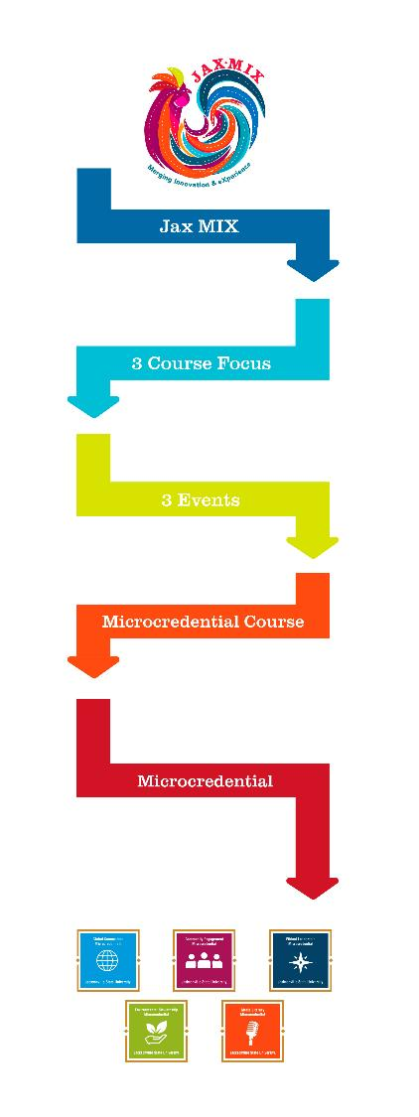
Optional Pathways within Jax MIX
Opportunity to focus your studies with a goal in mind.
Many of the courses within these pathways you have taken or will take during your time in general education!
Talk to your advisor if you are interested in completing a Focus. They can suggest the best course of action.
The next few sides will explain each step in the graphic in further detail
Back to Table of Contents

Slide 7
The First Step to Earn a Microcredential
To complete a Focus in a Pathway you must complete 1 course from each of these 3 categories:
Course 1, Course 2, and Course 3.
Courses in each category for each pathway are outlined on jsu.edu/jaxmix/pathways/focus
Back to Table of Contents

Slide 8
Another step to earn a microcredential is to attend 3 Events existing within a Pathway before, during, or after completing a focus.
Scan the Jax MIX QR code at each event to record your attendance in Credentials.
To see details of upcoming events in each pathway visit jsu.edu/jaxmix/pathways/events
Back to Table of Contents

Slide 9
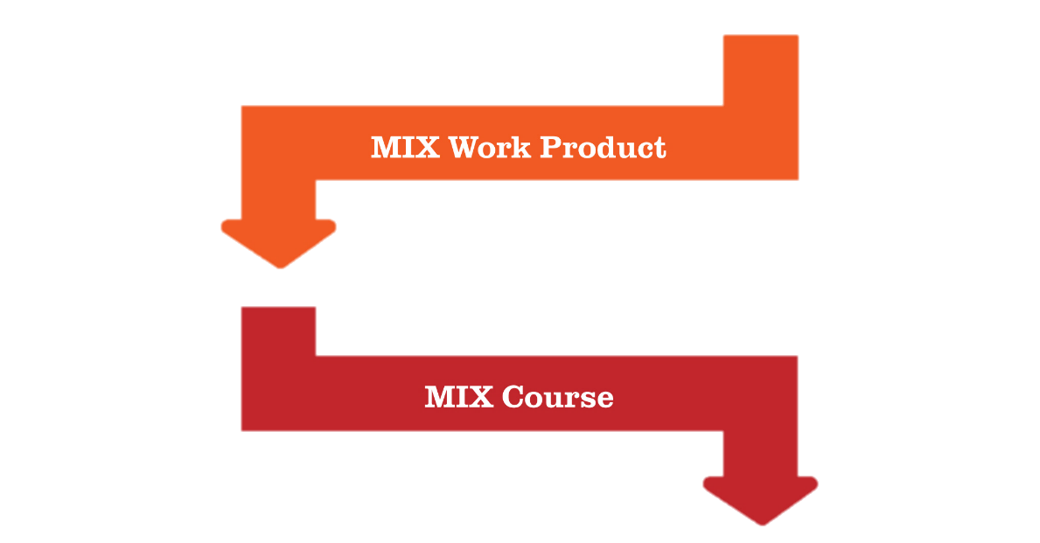
The Final Steps to Earn a Microcredential
Once you complete a focus, you can register for the MIX course associated with that microcredential through Banner, just like you would any college course.
Within this free microcredential course, you will submit a reflection on how your focus courses, event attendance, and work product achieve the competencies and skills of the Jax MIX microcredential.
A work product can include a longer traditional project from any course, an internship, study abroad, research, community service, etc. that relates to the Jax MIX microcredential.
Back to Table of Contents

Slide 10
Microcredentials give the students a purpose in Jax MIX (general education).
You have the opportunity to gain tangible evidence of the skills and knowledge you acquired during your time in Jax MIX.
Back to Table of Contents

Slide 11
Optional Microcredentials
To earn a Microcredential, you must:
Complete a 3 course Focus in a Pathway (courses outlined on jsu.edu/jaxmix/pathways/focus ) AND
Attend 3 events aligned with a Pathway AND
Enroll in a Microcredential course aligned with the Pathway where you will submit a work product (course/community service/leadership project) and write a reflection on what you learned through earning your microcredential.
Back to Table of Contents

Slide 12
Optional Microcredentials
Benefits:
Featured on your transcript.
Display to potential employers on your resume, LinkedIn, professional website, etc.
Demonstrate your accomplishments within Jax MIX.
Places you above other candidates showing you went beyond what was required of you in Jax MIX.
Back to Table of Contents

Slide 13
Explore More
Website
www.jsu.edu/jaxmix/
More Informational Resources
Jax MIX office
Brewer Hall 212
E-mail – Ask us about Jax MIX Ambassadors!
jaxmix@jsu.edu
Social Media
Instagram & Facebook
Back to Table of Contents

Slide 14
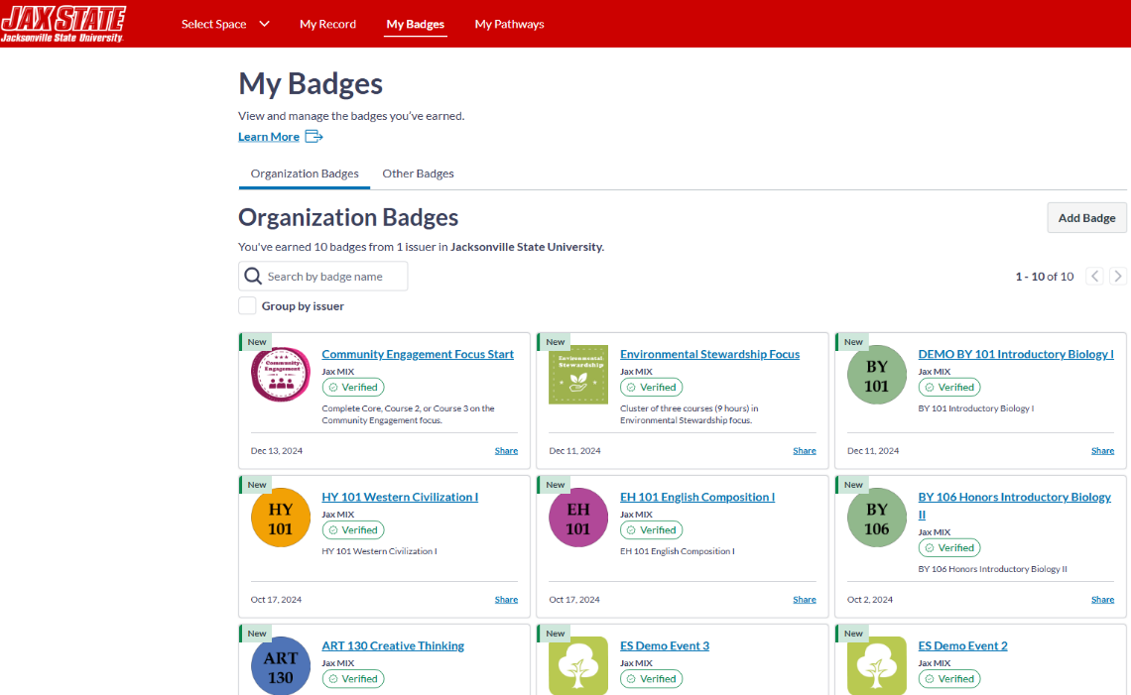
Software that keeps track of your progress, awarding milestone badges for each accomplishment through Jax MIX.
You will earn a milestone badge for completing courses, attending events, starting a focus, and completing a focus.
Why should I visit Credentials
jsu.badgr.com
Back to Table of Contents

Slide 15
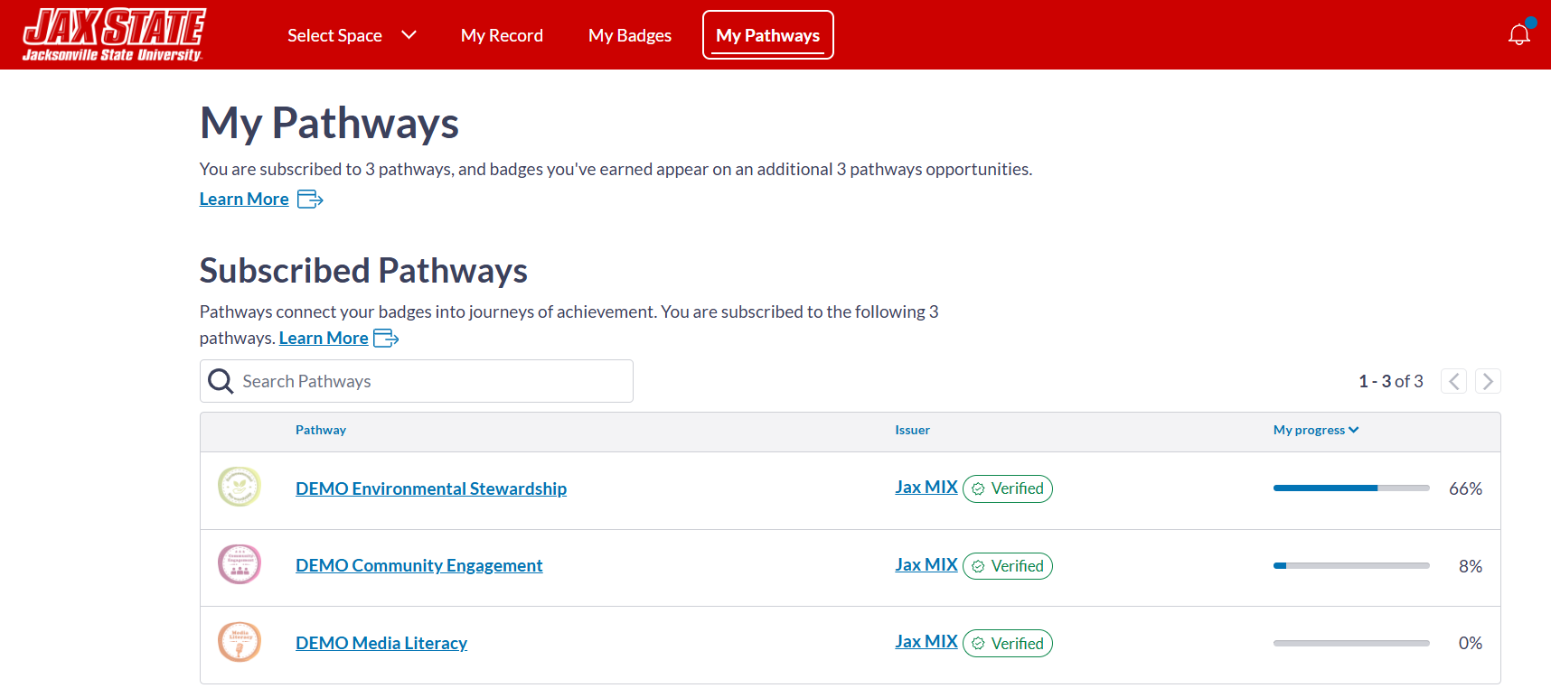
Software that keeps track of your progress through earning a Microcredential.
Why should I visit Credentials
jsu.badgr.com
Back to Table of Contents

Slide 16
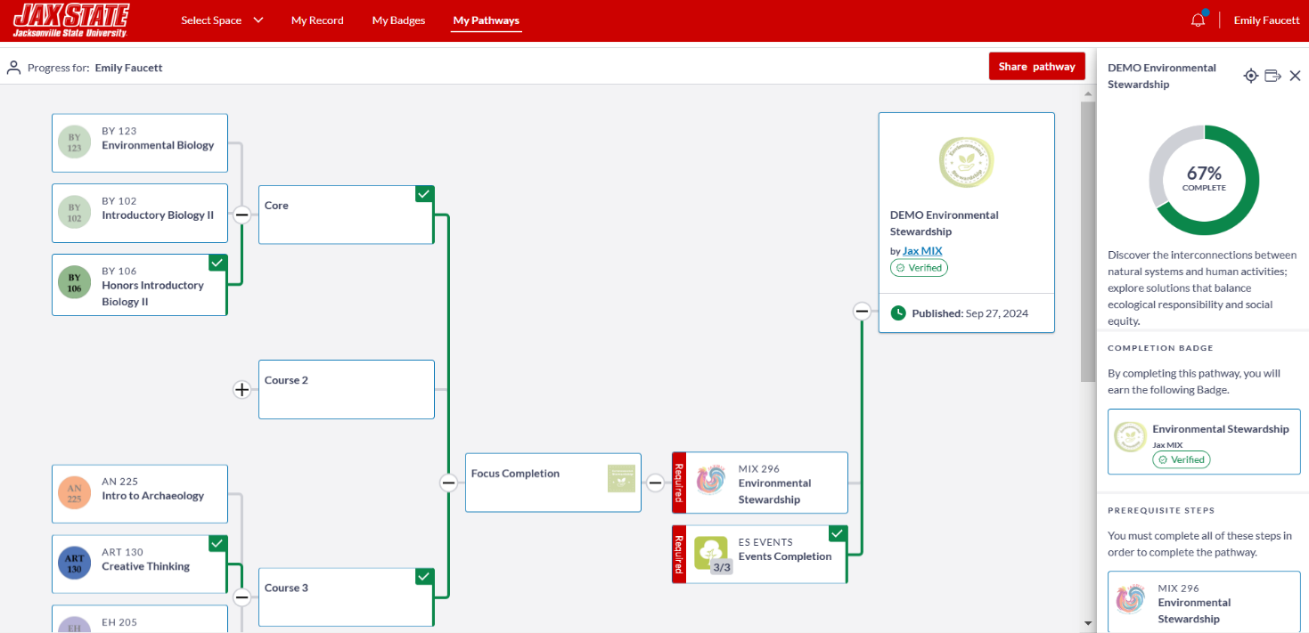
Software that breaks down the steps to earning a Microcredential.
Why should I visit Credentials
jsu.badgr.com
Back to Table of Contents

Slide 17
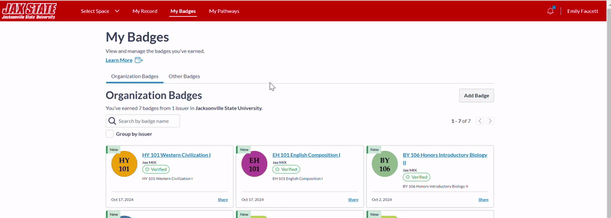
Add your personal email so you always have access to your accomplishments in Credentials.
Watch this short video to show you how.
Why should I visit Credentials
jsu.badgr.com
Back to Table of Contents

