Slide 1
Strategic Plan (RED Plan) Reporting Training

Slide 2
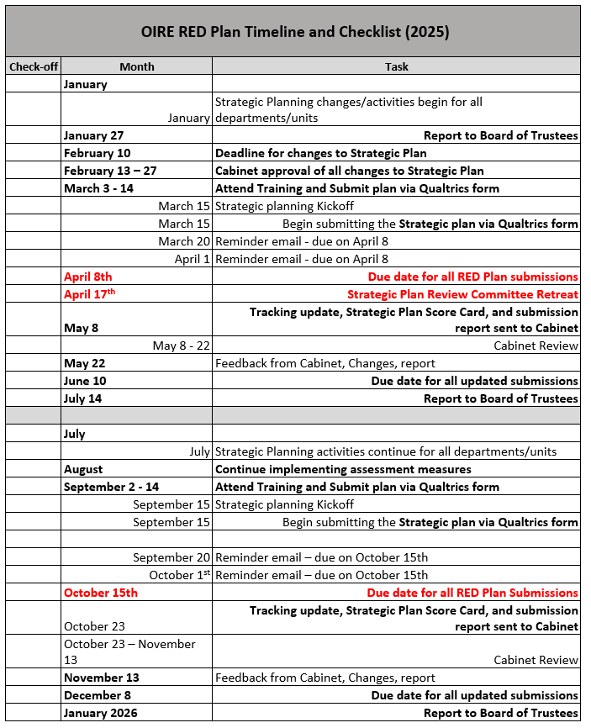
You are here
Note: Strategic Plan Review Committee will review only once per year.
Submissions twice a year
Note: Strategic Plan Final Spring of 2025 Report for BOT in January

Slide 3
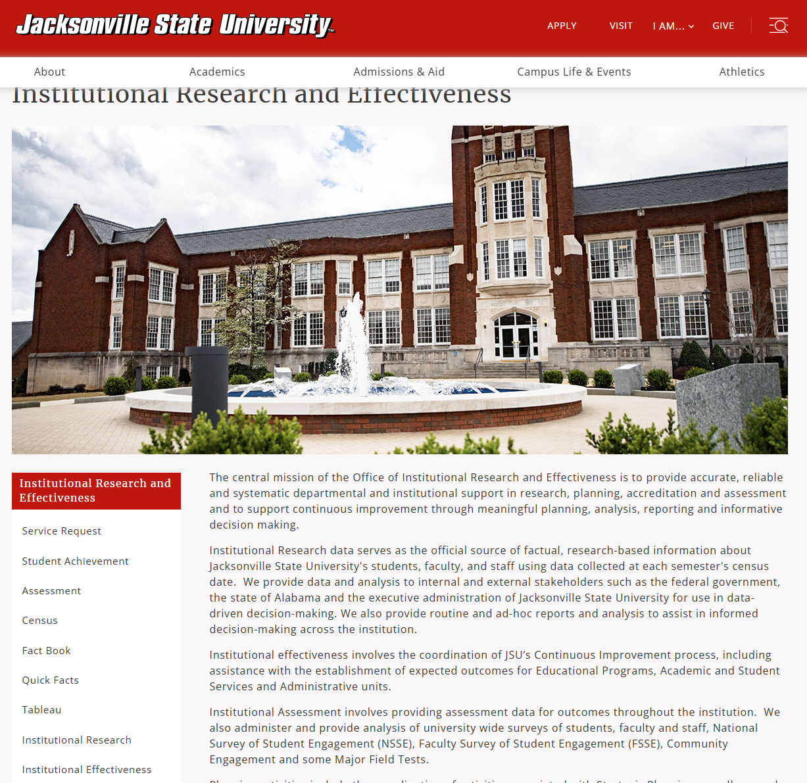
Where can I find the forms needed for submission?

Slide 5
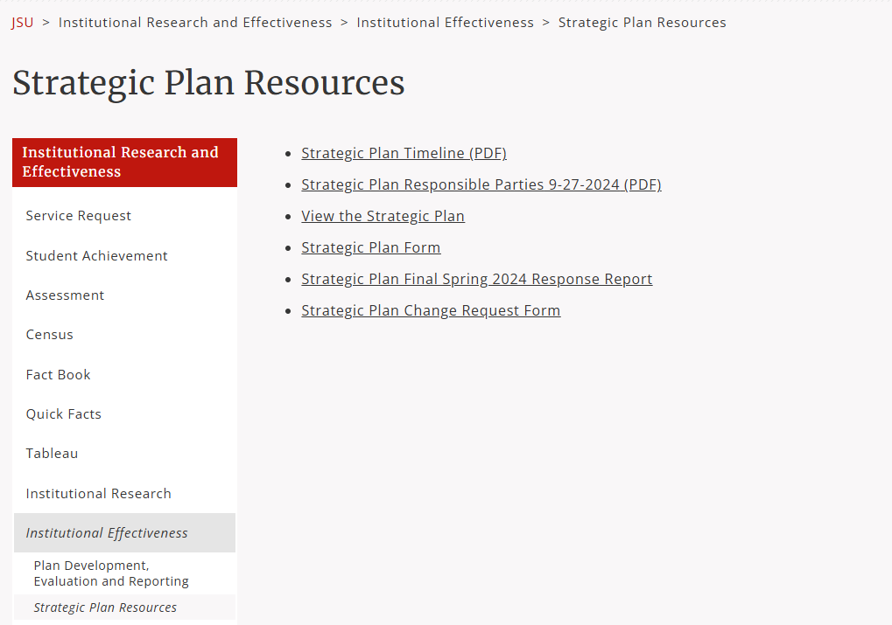

Slide 6
Strategic Plan Reporting Form
Reach
Engage
Discover

Slide 7
1. Inclusive Environment
2. Spirit of Generosity
3. Culture of Accountability
Objective 1
Objective 2
Objective 3

Slide 8
Submission
Note: One narrative submission per strategy.
Purpose
Measuring progress
Current level of progress
Target or end-goal
Result
Next steps
Drag file to upload
Click Submit
Note: Please do not upload any supporting documentation. Links/embedded documents may be included with in the body of the narrative but will not be accepted as the narrative.
Strategy 1
Strategy 2
Strategy 3

Slide 9
Review of Reports Submissions
Strategic Plan Review Committee (SPRC)– review of submissions.
Overall goal of the committee is to determine if the overall objectives are being met across the institution.
May make recommendations or provide feedback
Rubric
Feedback will be sent to responsible parties for review and responsible parties can make any updates to the report before final submission of report.
SPRC Committee will update the Strategic Plan Balanced Scorecard
Strategic Plan Balanced Scorecard Report will be submitted to Cabinet for review and feedback.
Final reporting of outcomes to Board of Trustees in January and July of every year based on the Continuous Improvement Policy

Slide 10
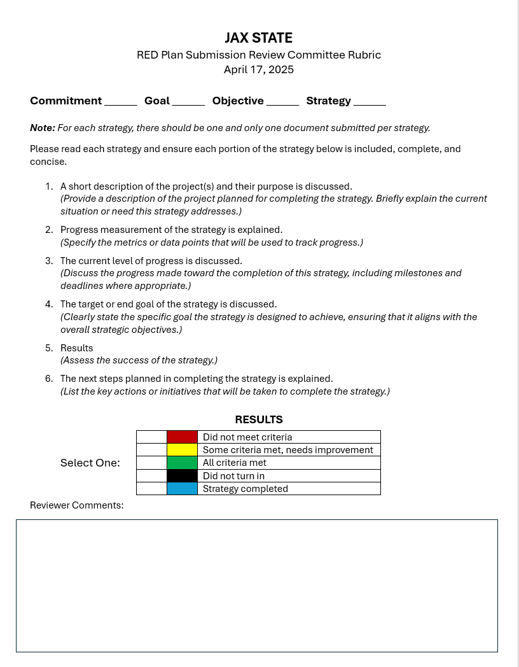

Slide 11
Key take aways
Submissions are due twice a year for reports (April and October)
Only submit one narrative per strategy; if more than one activity is happening or if more than one unit/responsible parties are working on the same strategy, you will need to work together to incorporate all work being done across the campus for the one strategy into one narrative report
Note: Please do not upload any supporting documentation. Links or embedded documents may be included in the narrative but will not be accepted as the narrative.
Reports will be reviewed by the Strategic Plan Review Committee annually
Outcomes are reported to BOT twice a year (January and July)

Slide 12
Questions? Thank you!

