Slide 1
RED Plan
Jacksonville State University
Strategic Plan
Dr. Marie A. Valentin
Assistant Vice-Provost, Institutional Research and Effectiveness

Slide 2
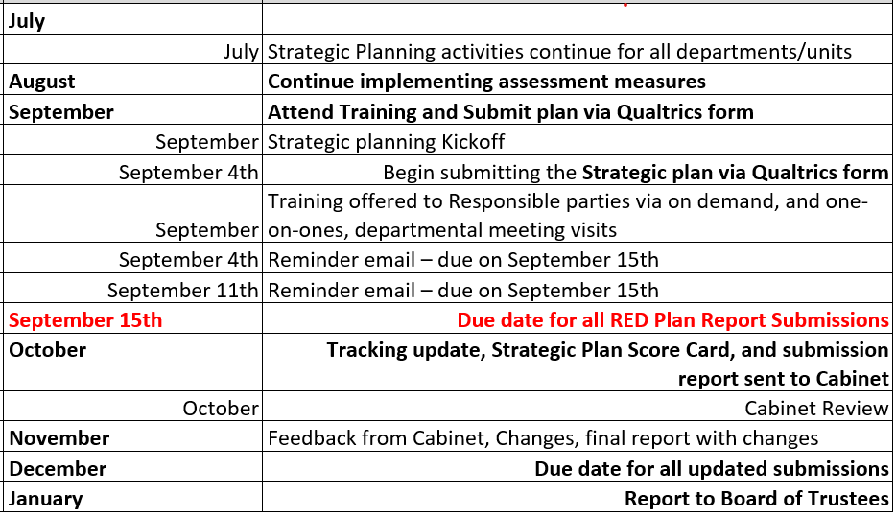
OIRE RED Plan Timeline and Checklist (2023)

Slide 3
2023 RED Plan Tracking Report

Slide 4
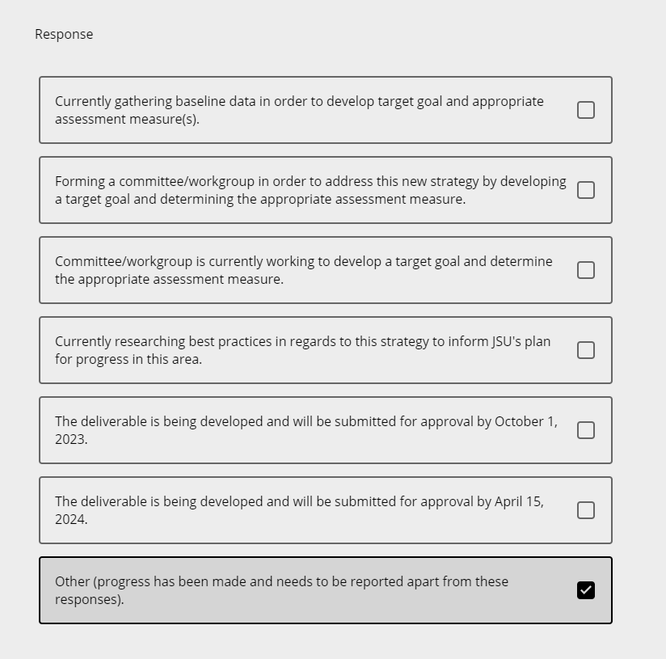
Previous options will no longer be available
These responses will become the base line Action Plan in the Scorecard for 2023

Slide 5
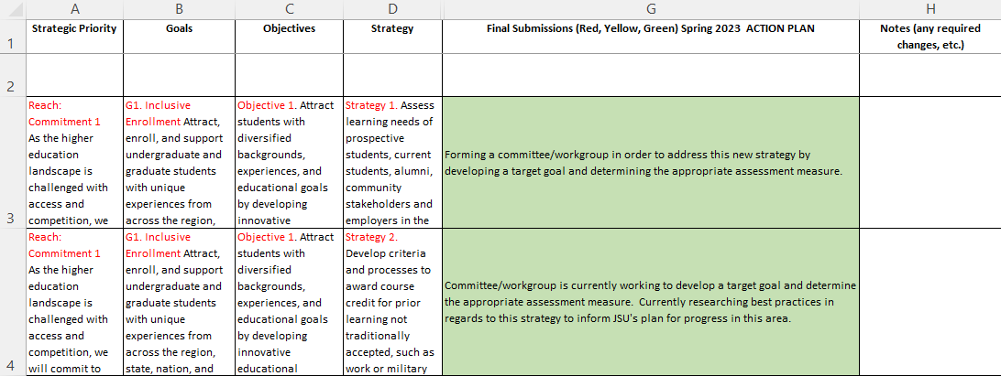
2023 RED Plan Tracking Report
Base Line ACTION PLAN

Slide 6
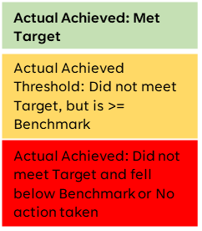
RED Plan Scorecard

Slide 7
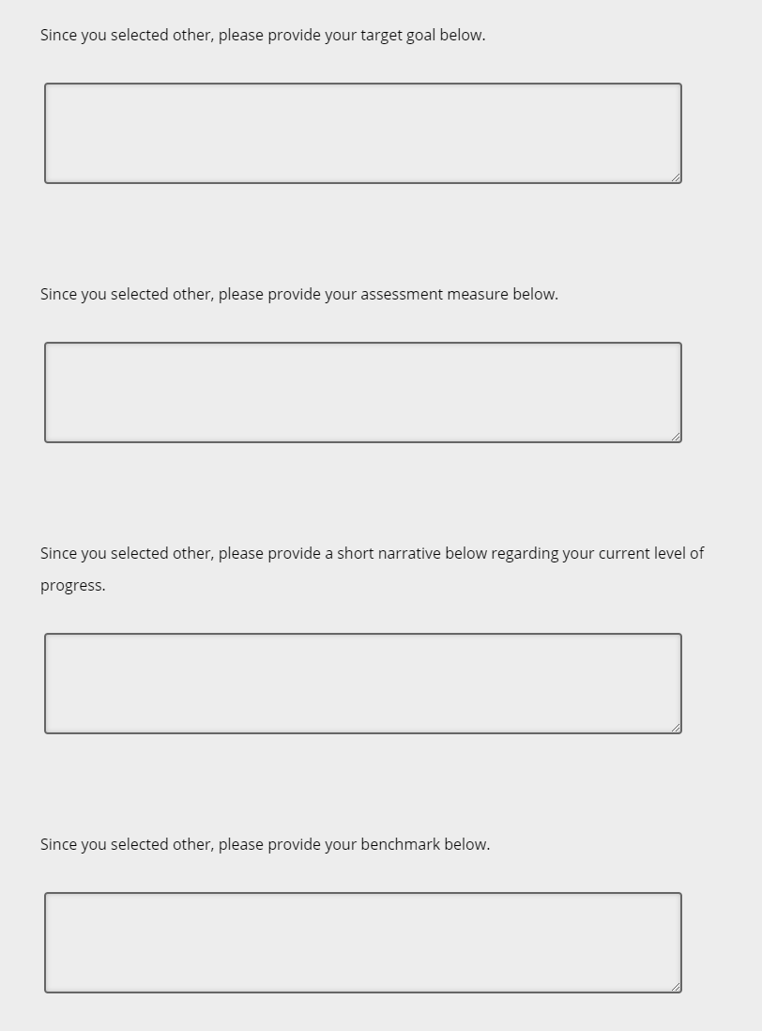
Target
These sections will now need to be included in the Qualtrics Form:
Measure
Also report:
Action Plan
Status of Progress
Results
Progress
Benchmark

Slide 8
Definitions
Action Plan
A plan or course of action to achieve a particular purpose.
Measure
Is used to classify, categorize, or quantifying variables
Benchmark
A standard or point of reference against which things may be compared or assessed.
A goal to be achieved.
Actuals Achieved
Target
Actual Achieved: Met Target
Actual Achieved Threshold: Did not meet Target, but is >= Benchmark
Actual Achieved: Did not meet Target and fell below Benchmark or No action taken

Slide 9
Example used: Reach, Goal 1: Inclusive enrollment, Objective 2: Increase the enrollment of undergraduate and graduate students, Strategy 2: Enhance enrollment and retention efforts in graduate programs.
Response submitted: Goal: To implement the Academic Partnership collaboration for Fall 2023 to increase enrollment in the Master of Business Administration. Assessment: To evaluate enrollment data across academic terms to assess program growth. Current State of progress: This initiative launched in January 2023 with an initial kick-off meeting and program evaluation period. Steps to enhance the academic program are ongoing and all elements of the initial marketing launch are on target. Market Go Live is scheduled for release on May 17, 2023, and serves as the transition of the MBA program to a managed program with Academic Partnerships. Benchmark: to see a 5% increase across terms in program enrollment.
Action Plan
A plan or course of action to achieve a particular purpose. (i.e., Implement the Academic Partnership collaboration for Fall 2023 to increase enrollment in the Master of Business Administration)
Measure
Is used to classify, categorize, or quantifying variables (i.e., increase overall headcount by 5% per academic year for fall and spring semesters)
Benchmark
A standard or point of reference against which things may be compared or assessed. (i.e., enrollment headcount Fall 2023 – 9,500)
A goal to be achieved. (i.e., 5% increase in enrollment headcount from 9,500 to 9,975)
Actuals Achieved
Target

Slide 10
Example used: Reach, Goal 2 Spirit of Generosity, Objective 4 Increase the overall participation in the “All In Employee Giving Campaign”.
Response submitted: Target goal: For 2022, our goal was to increase the participation and we achieved a 10% increase from 2022. Assessment Measure: Rate of participation. Current level of progress: We are currently tracking for another increase for the 2023 campaign. Benchmark: Benchmark for 2022 was 17% and benchmark for 2023 is 27%.
Action Plan
A plan or course of action to achieve a particular purpose. (i.e., none stated, What is a good action plan for this example? Advertise earlier and more frequent)
Measure
Is used to classify, categorize, or quantifying variables (i.e., increase overall participation by 17%)
Benchmark
A standard or point of reference against which things may be compared or assessed. (i.e., Current employee enrollment 5,700 employees enrolled)
A goal to be achieved. (i.e., 17% increase in enrollment headcount from 5,700 to 6,669 a 969-participant increase)
Actuals Achieved
Target

Slide 11
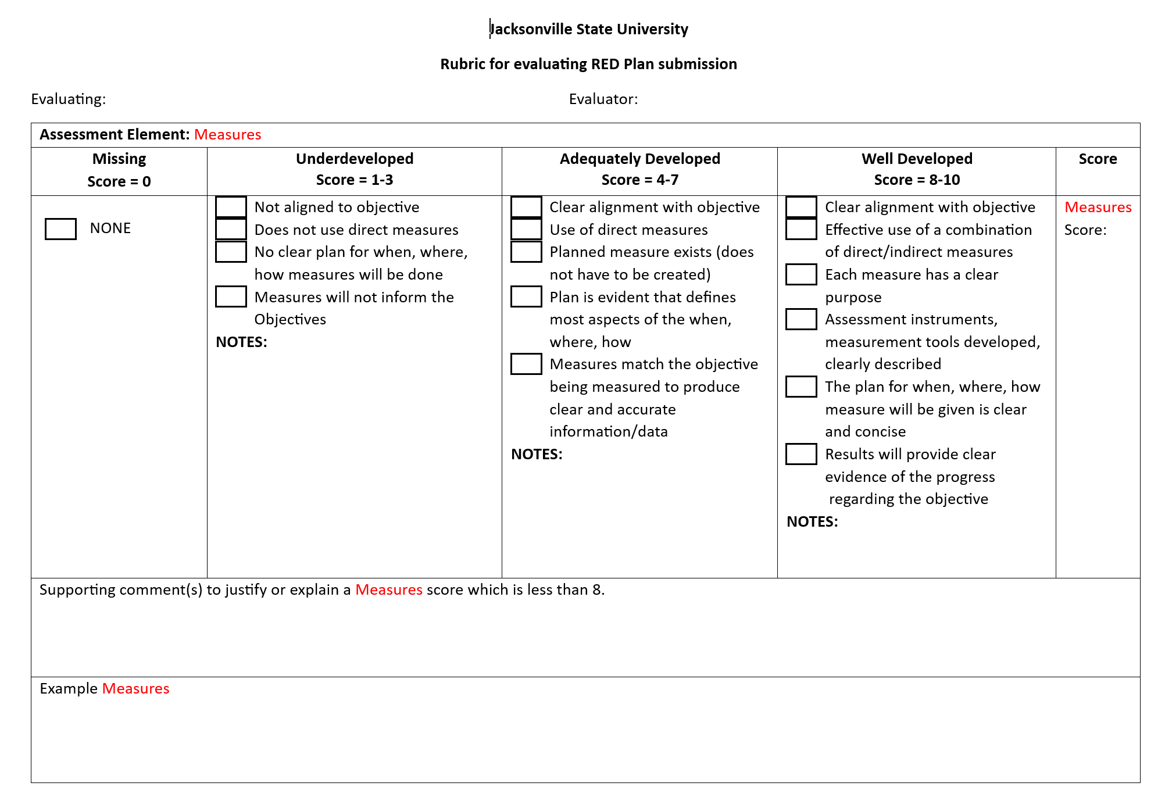
RUBRICs Measures Targets Findings Action Plan Outcomes analysis

Slide 12
Tips to remember
1
Keep continuous improvement in mind as you assess: This means that the base line action plan will be changing every year to endure that the action creates the desired results over time.
2
Think “integrated”: Strategic planning should not be a separate and unique effort…it should be a way to focus your actions related to the overarching University goals and objectives that you are trying to attain anyway.
3
Think “ongoing”: success is planned for, monitored and measured throughout the year. ‘You track what you think is important”, this should be an ongoing process.
4
Be sure that you define one or more measures for each strategy: Having measures ultimately results in quantifiable data (evidence), so each outcome/objective must have some identified means to assess progress. Having multiple means of measurement offers a means to double-check (triangulate) your evidence to provide a more complete picture.
When in doubt refer to the RED Plan Rubric

Slide 13
Training, one-on-ones, on-demand, and resources:
Please email mvalentin@jsu.edu to schedule a one-on-one or join in on one of our on-demand (schedule to follow) for help in submitting your RED Plan submission.​
Resources: All of these resources can be found on the Institutional Research and Effectiveness website.

Slide 14
Questions?

Slide 15
THANK YOU
Dr. Marie A. Valentin
mvalentin@jsu.edu

